Slide 1

Summary results of our bi-annual
Central Eastern Europe business benchmarking survey
December 2016

Slide 2
Content
Respondents
Country ranking
Priority markets
Hiring plans
Headcount
Marketing/sales cost
Receivables
Staff turnover
Downtrading
Route-to-market
Do you expect to meet your original CEE budget in 2016?
Other issues
CEE aggregate
CE & Baltics aggregate
SEE aggregate
CIS aggregate
By market:
Albania
Armenia
Azerbaijan
Belarus
Bosnia-Hercegovina
Bulgaria
Croatia
Czech Republic
Estonia
Georgia
Hungary
Kazakhstan
Latvia
Lithuania
Macedonia
Poland
Romania
Russia
Serbia
Slovakia
Slovenia
Turkey
Ukraine
Note: missing series mean insufficient responses for that sector.

Slide 3
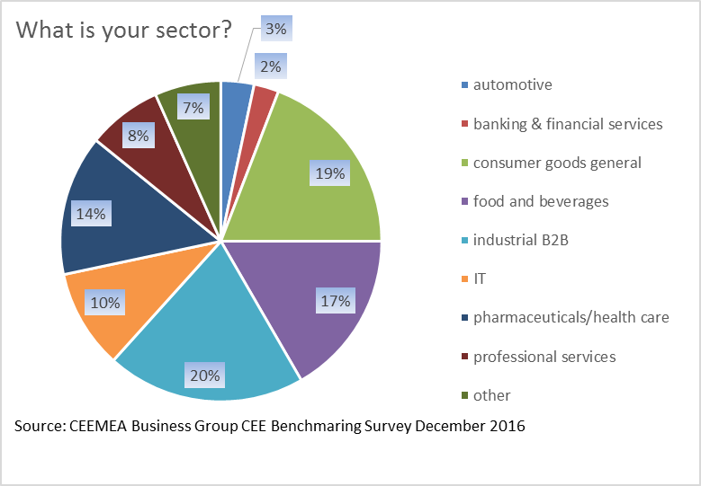
The sector breakdown of member companies responding to our December 2016 business benchmarking survey

Slide 4
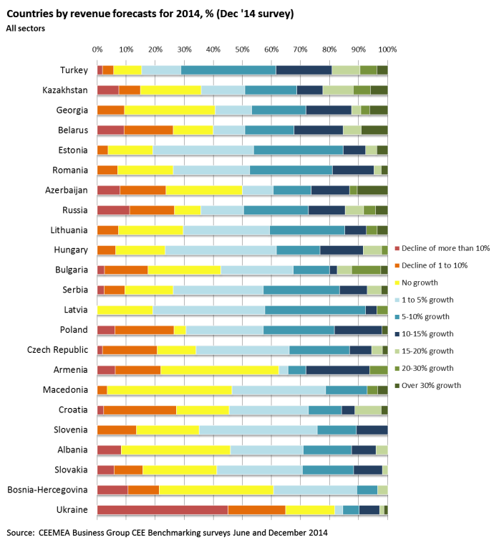
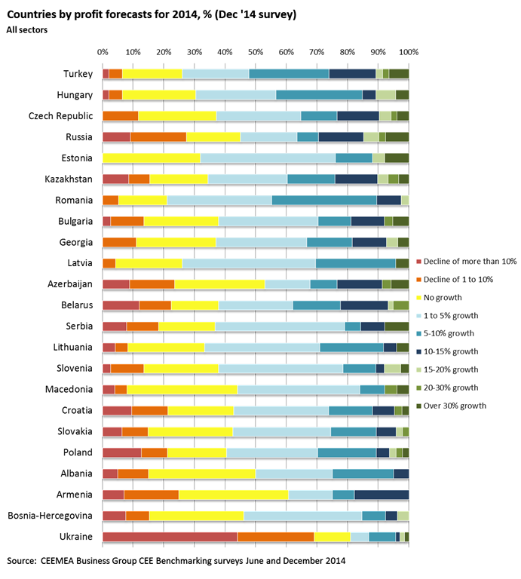
Countries by revenue and profit growth, 2014

Slide 5
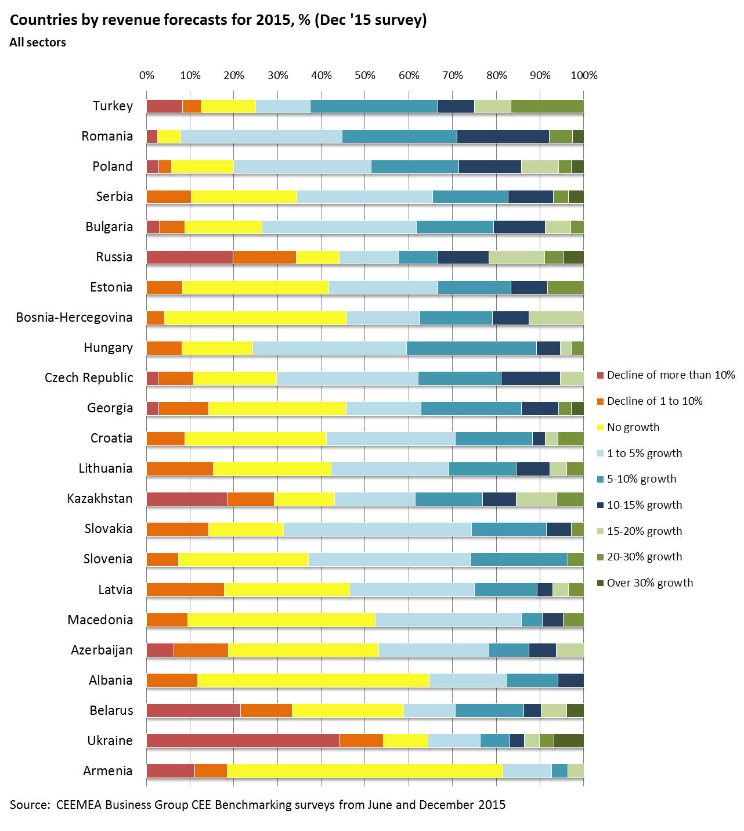
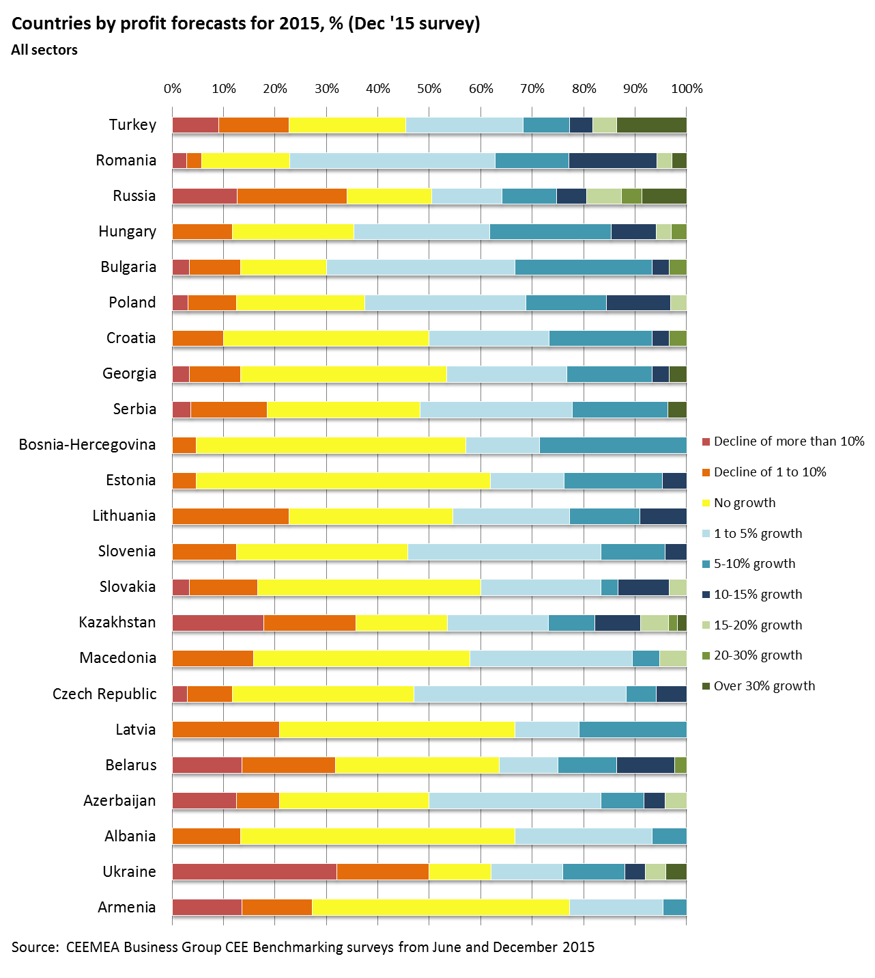
Countries by revenue and profit growth, 2015

Slide 6
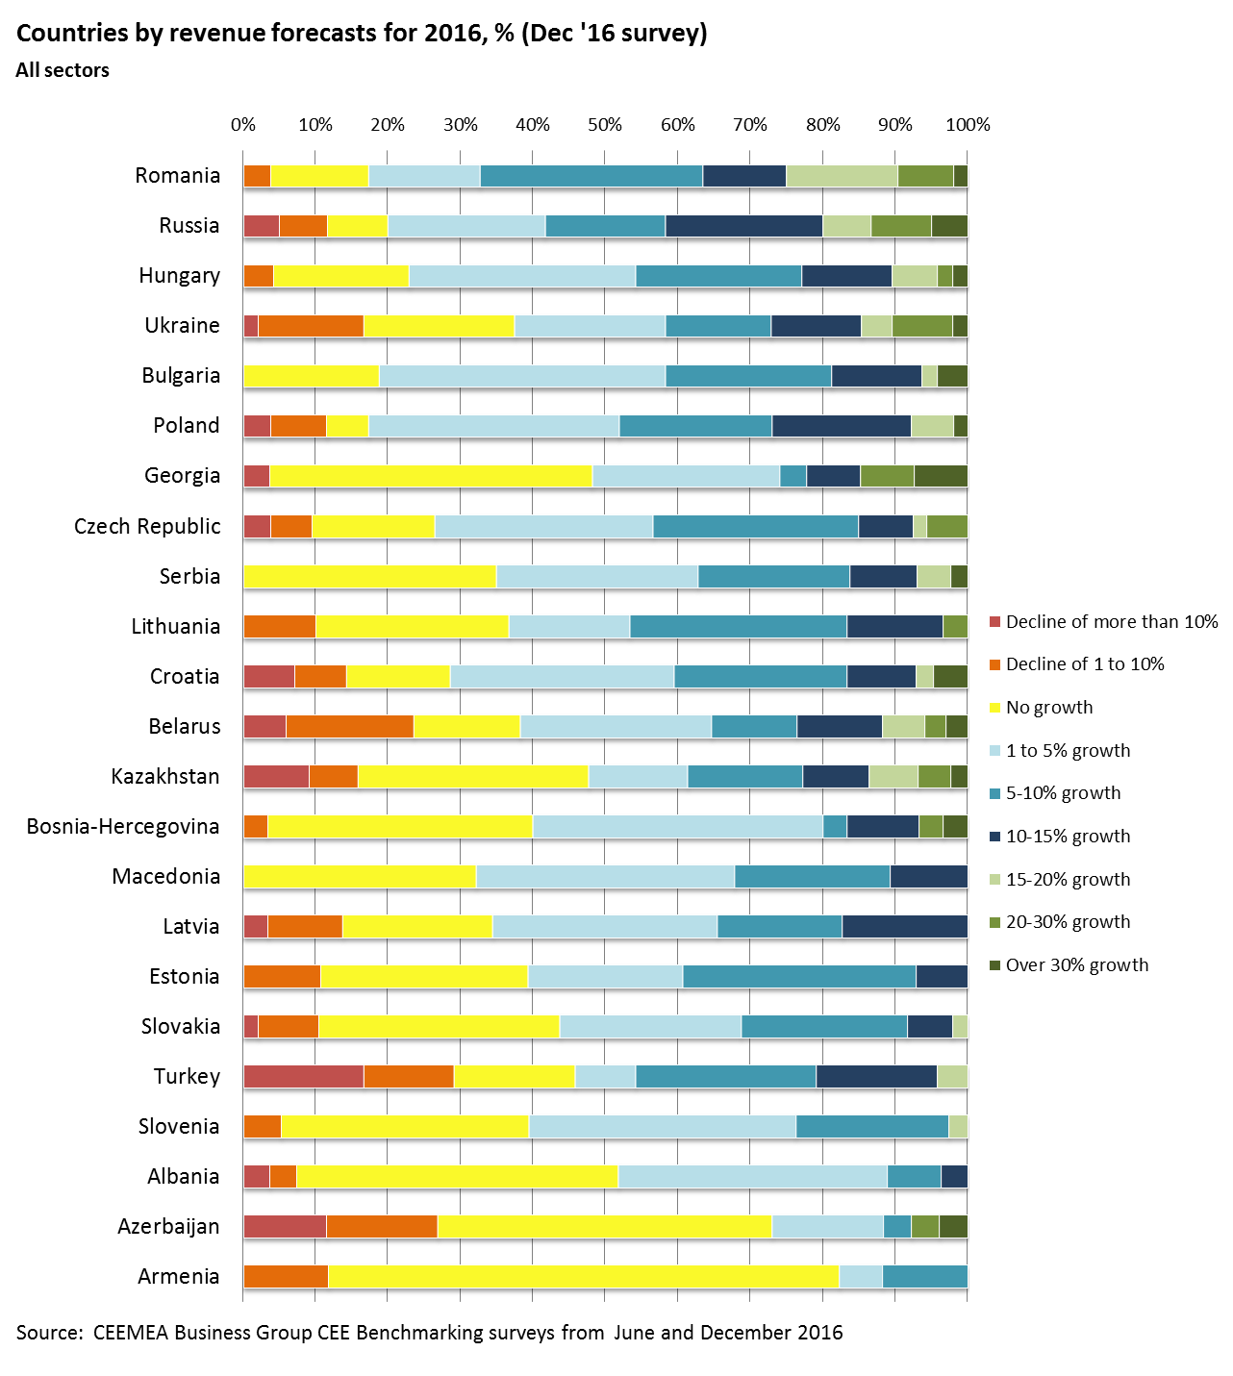
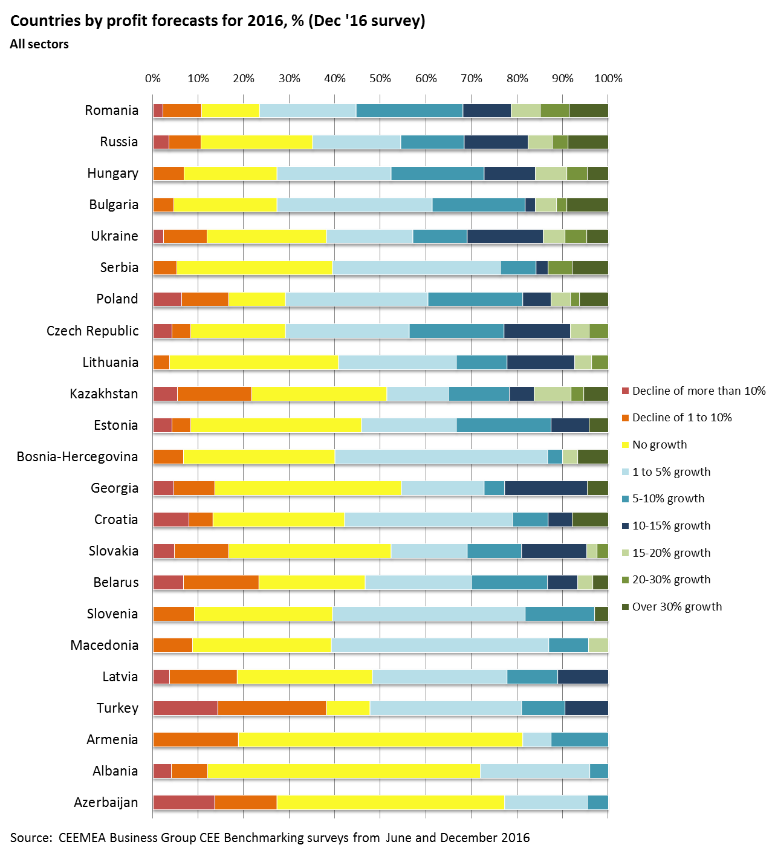
Countries by revenue/profit expectations for 2016
Based on December 2016 survey

Slide 7
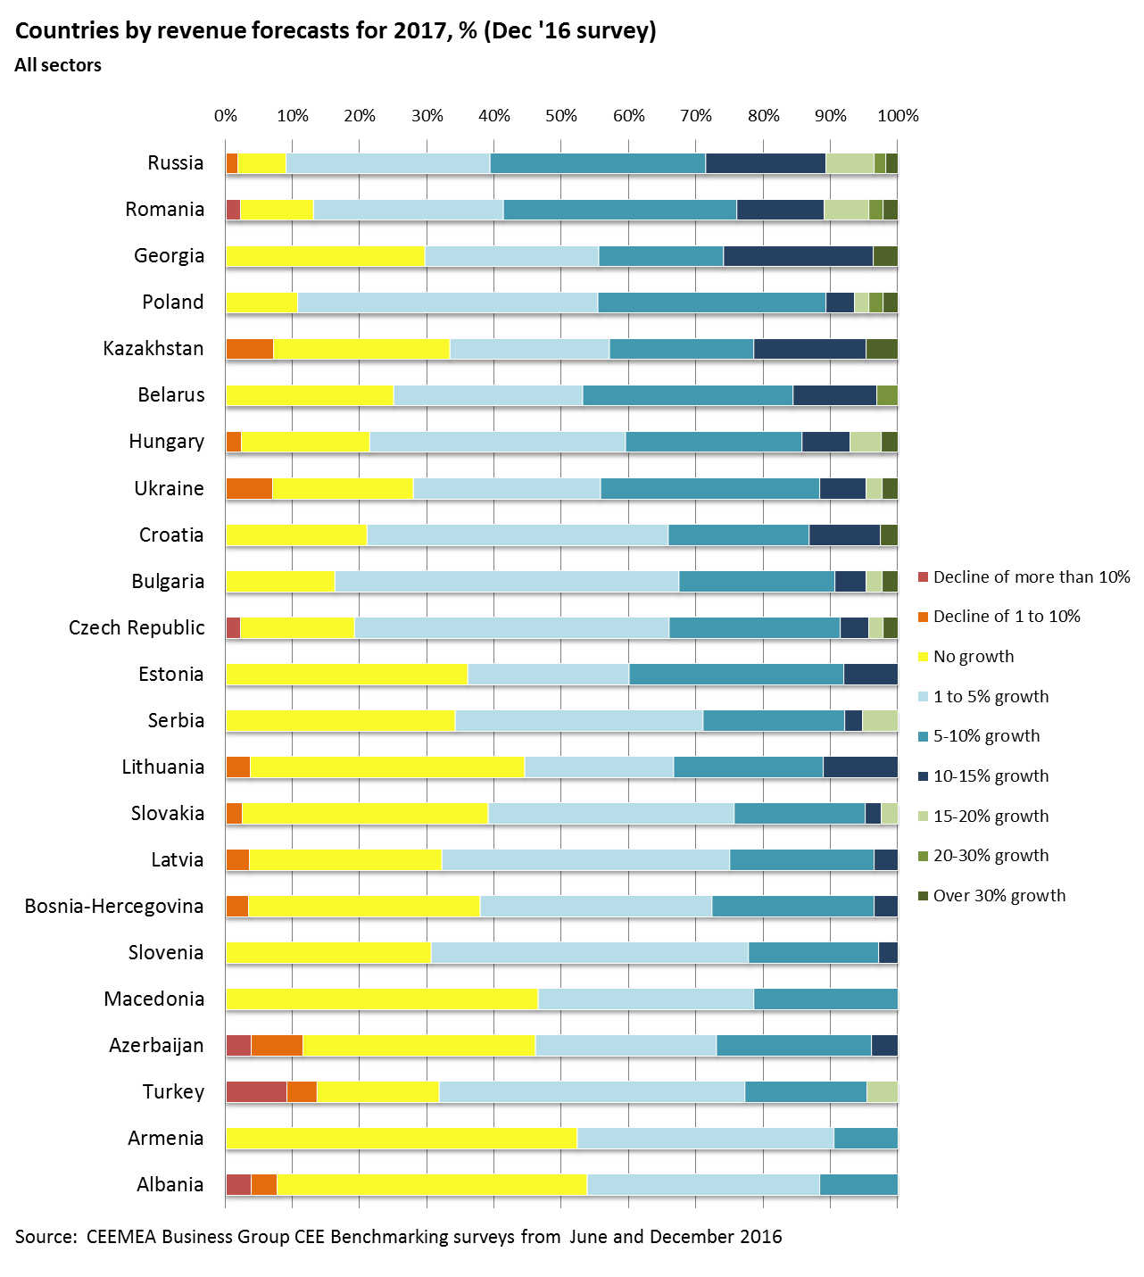
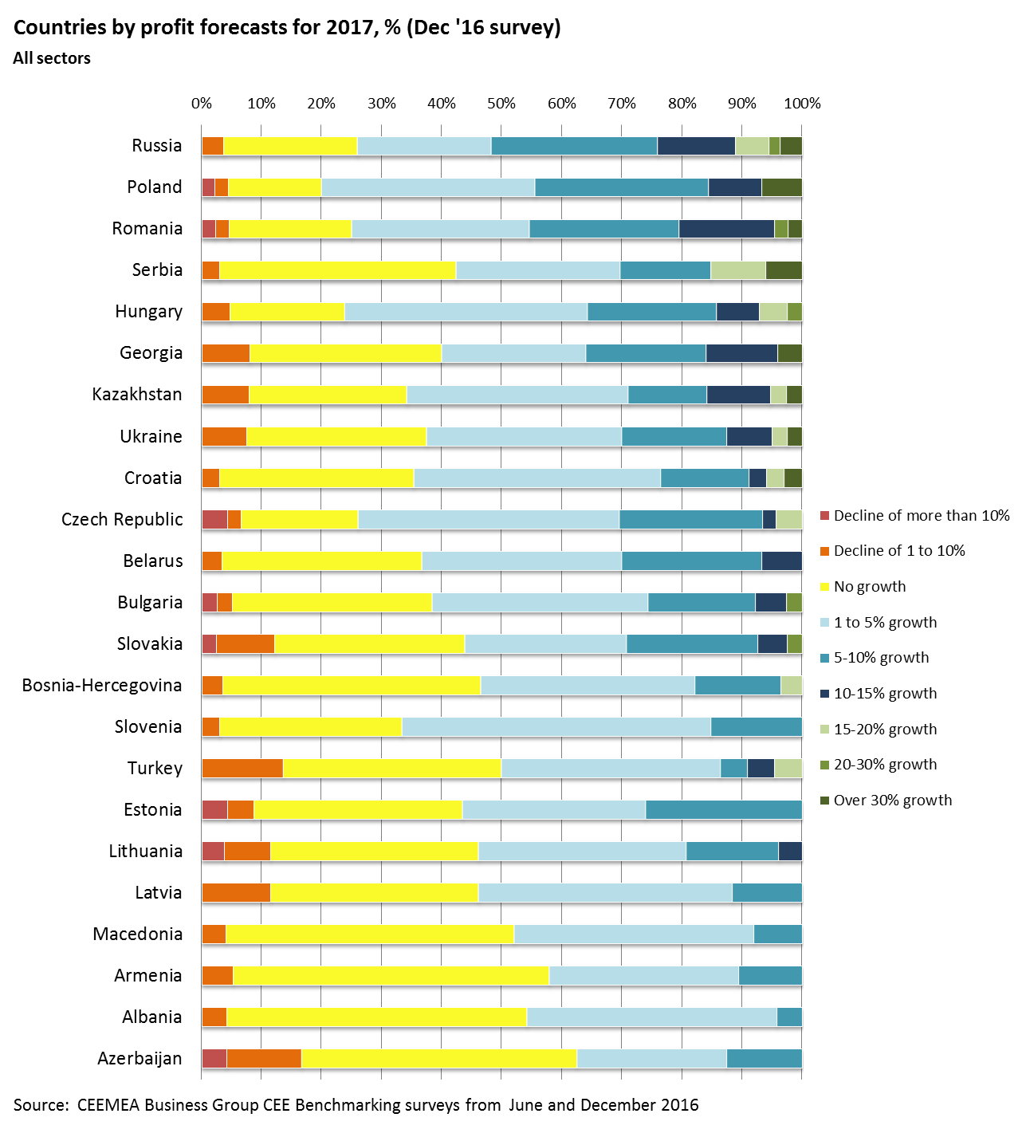
Countries by revenue/profit expectations for 2017
Based on December 2016 survey

Slide 8
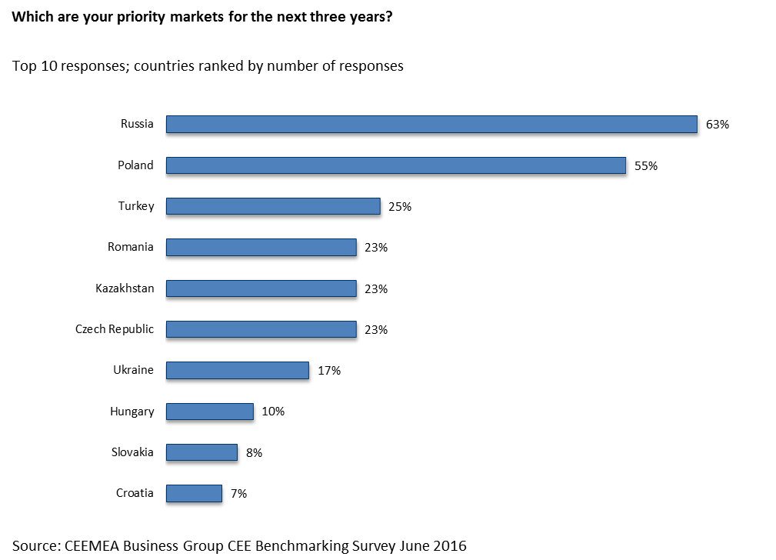
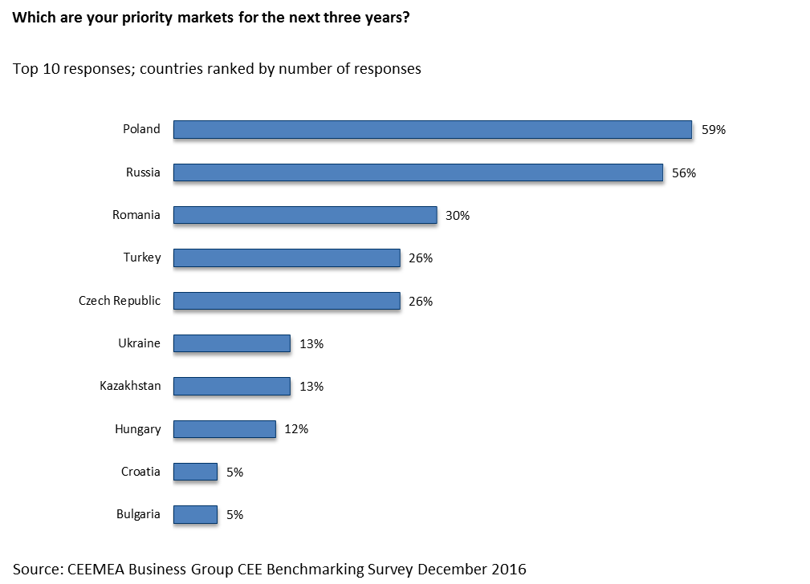
Priority markets for business development for the next three years
June 2016 vs. December 2016

Slide 9
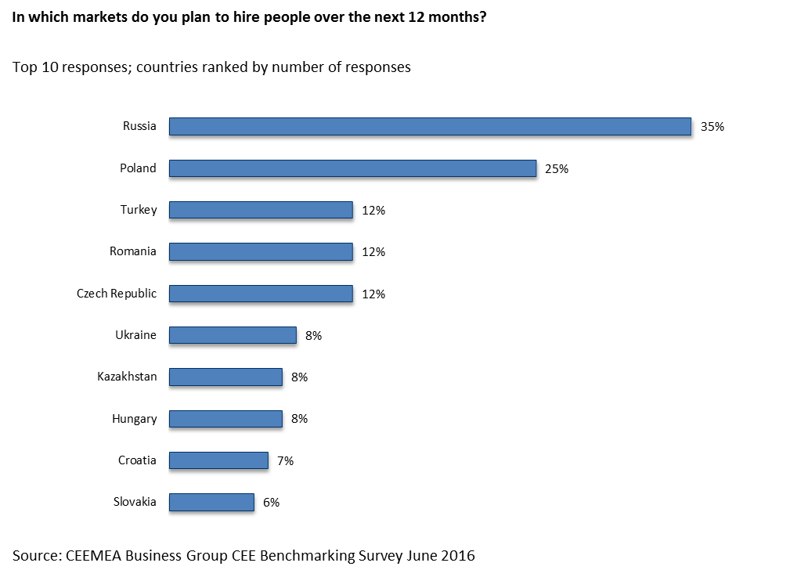
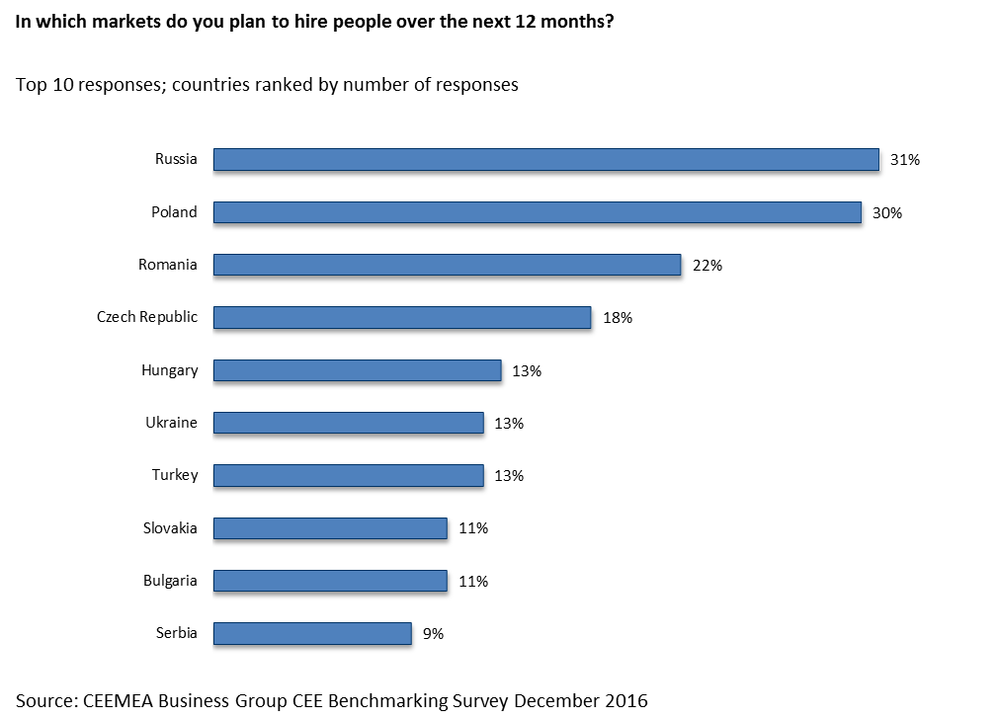
Top markets for hiring intentions over the next 12 months
June 2016 vs. December 2016

Slide 10
Cutting headcount?
December 2016

Slide 11
Cutting sales or marketing costs?
December 2016

Slide 12
Difficulties with receivables
December 2016

Slide 13
Have you seen higher staff turnover?
December 2016

Slide 14
Downtrading?
December 2016

Slide 15
Route-to-market
December 2016

Slide 16
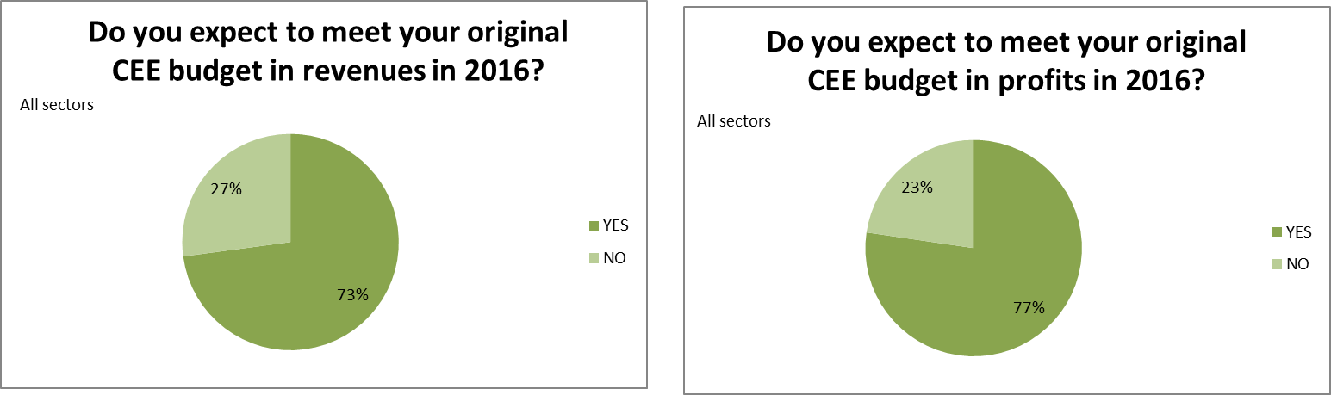
Do you expect to meet your original CEE budget in 2016?
December 2016 survey

Slide 17
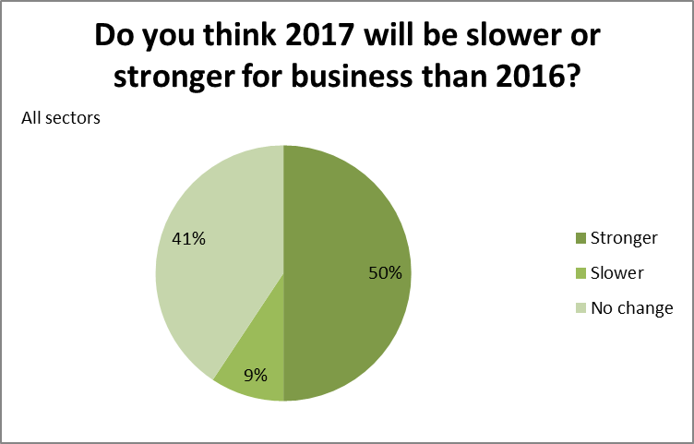
Other issues
December 2016 survey

Slide 18
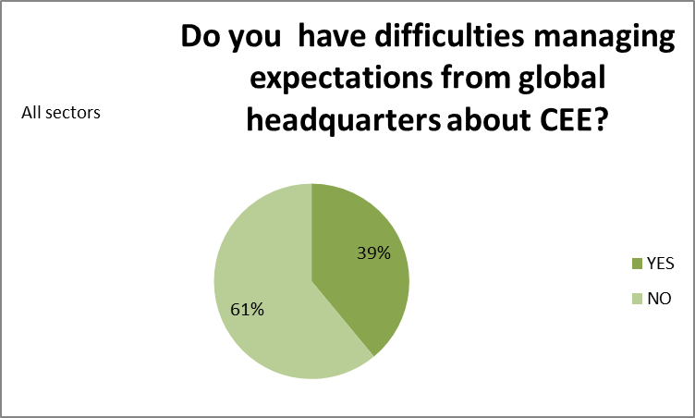
Other issues
December 2016 survey

Slide 19
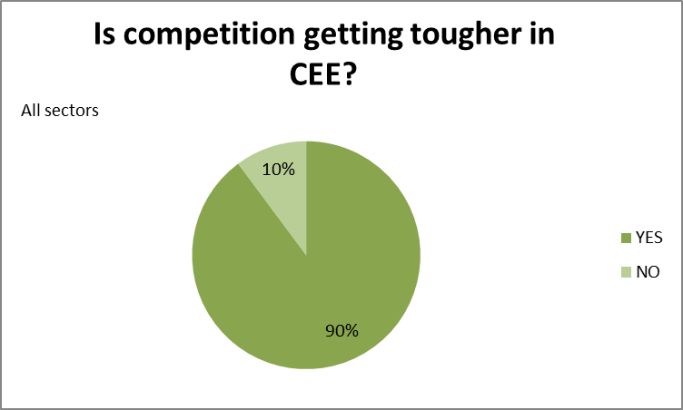
Other issues
December 2016 survey

Slide 20
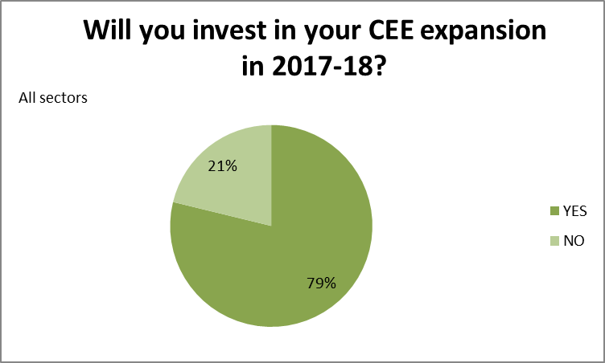
Other issues
December 2016 survey

Slide 21
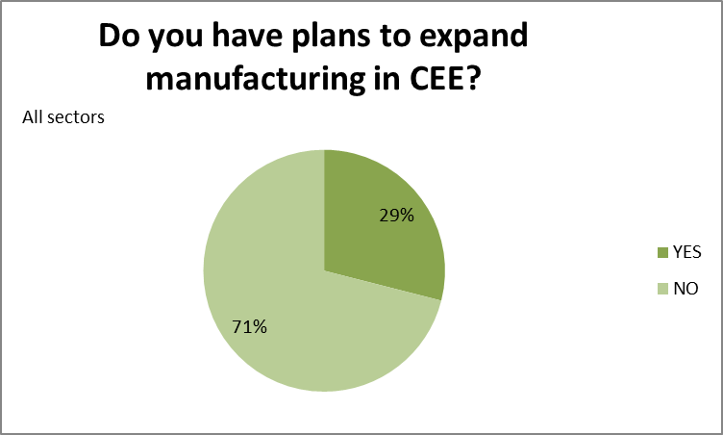
Other issues
December 2016 survey

Slide 22
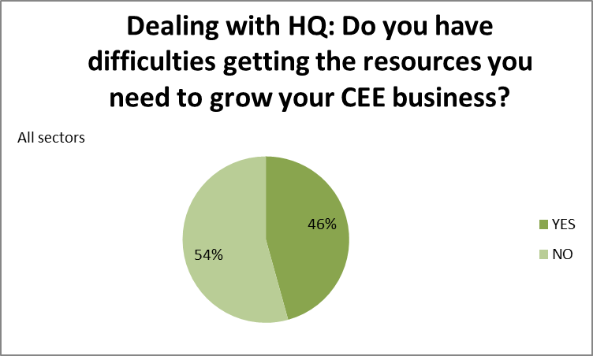
Other issues
December 2016 survey

Slide 23
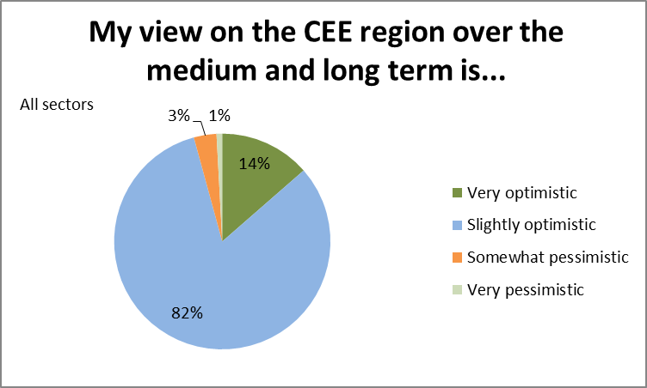
Other issues
December 2016 survey

Slide 24
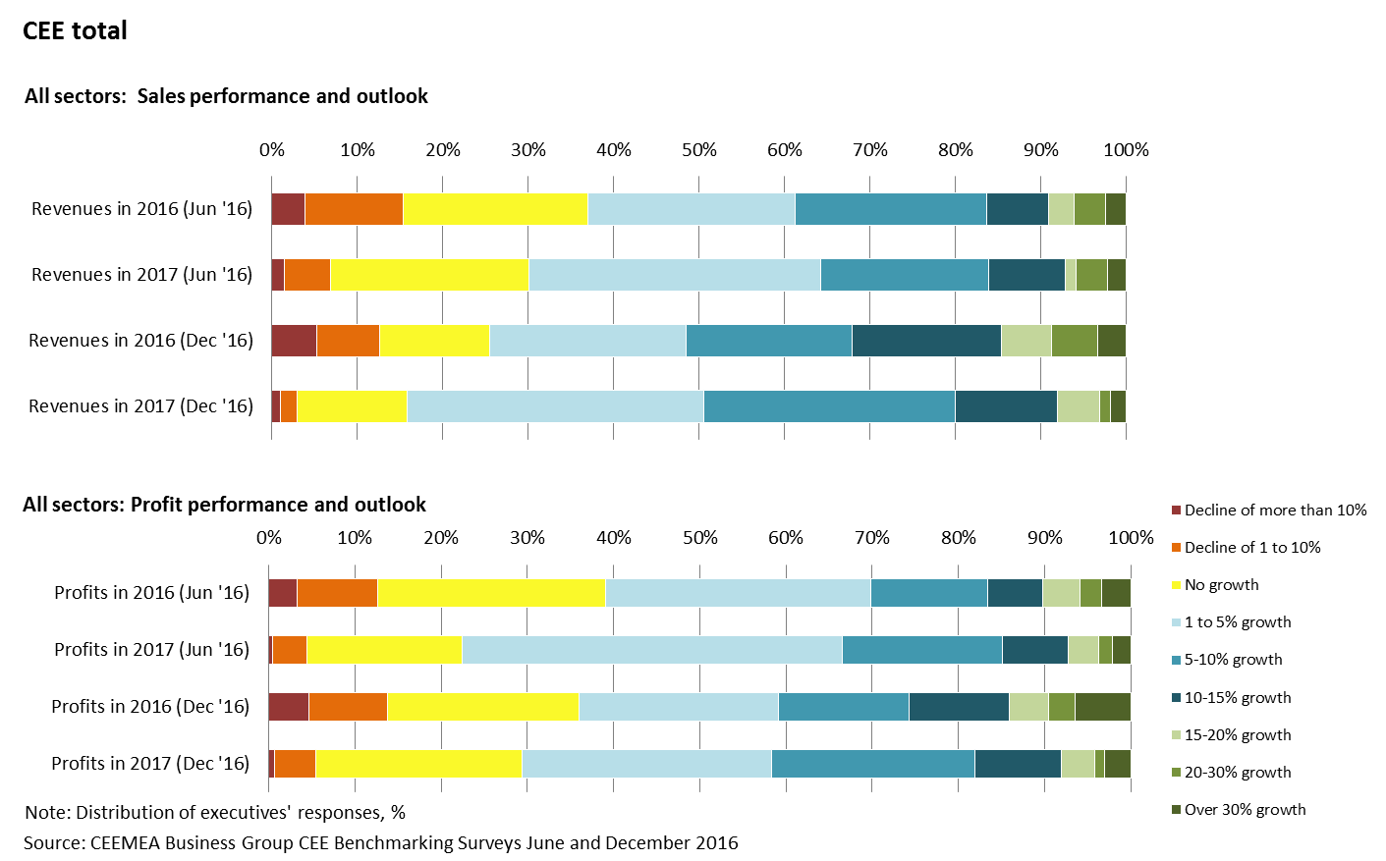
CEE aggregate
Corporate revenue and profit results and forecasts, 2016-17, all sectors
Comparison of our June and December 2016 surveys

Slide 25
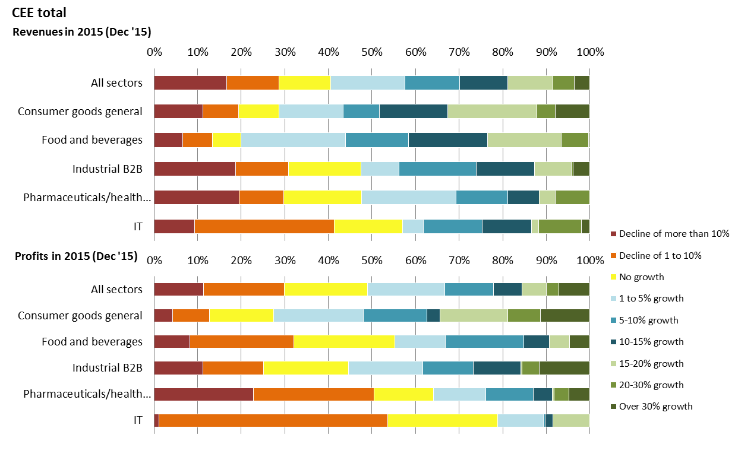
CEE aggregate
Latest estimates: revenue and profit results by sector, 2015
From our December 2015 survey

Slide 26
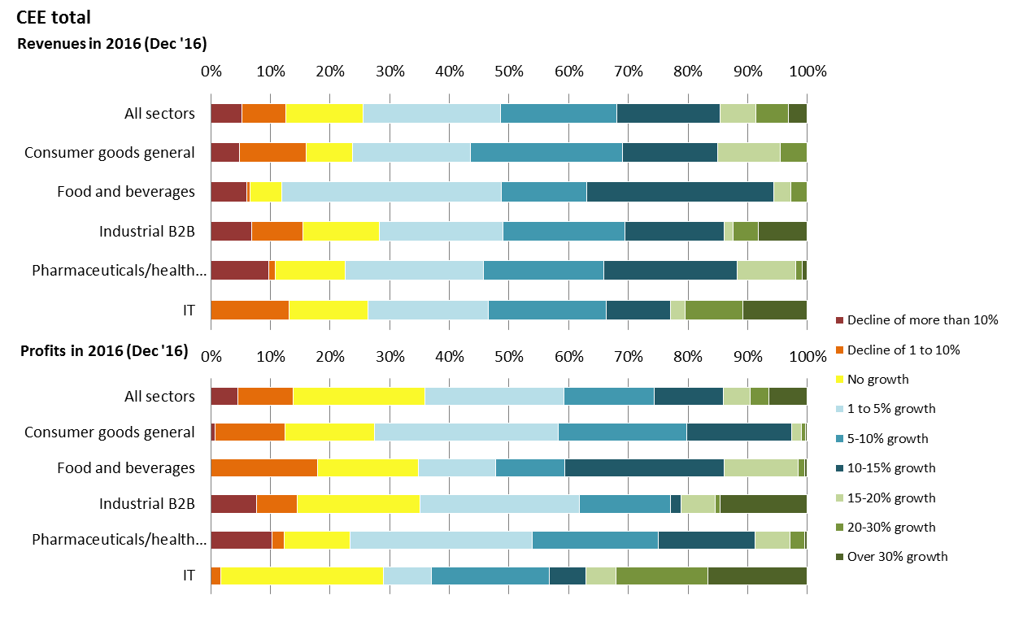
CEE aggregate
Latest forecasts: revenue and profit results by sector, 2016
From our December 2016 survey

Slide 27
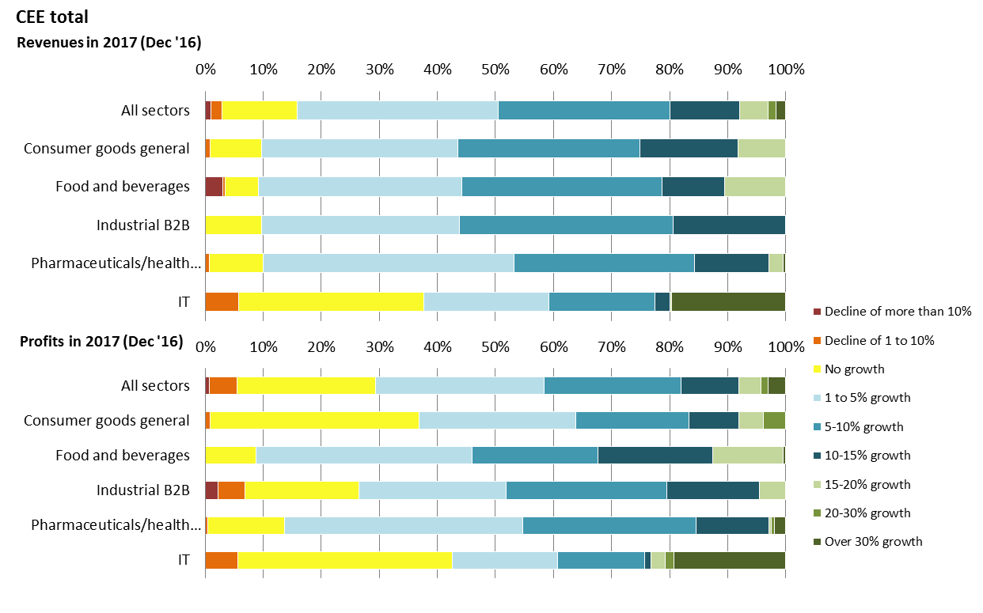
CEE aggregate
Latest forecasts: revenue and profit results by sector, 2017
From our December 2016 survey

Slide 28
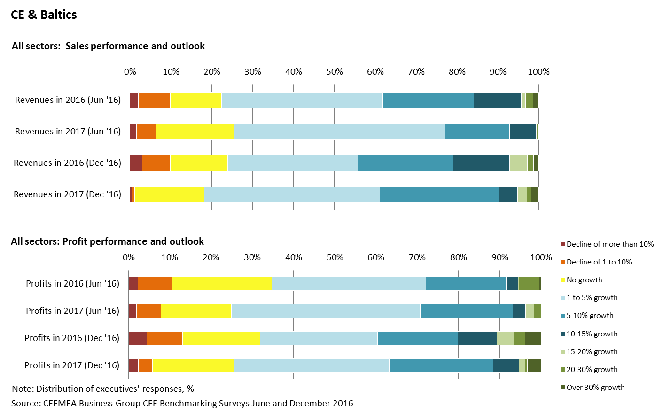
CE & Baltics aggregate
Corporate revenue and profit results and forecasts, 2016-17, all sectors
Comparison of our June and December 2016 surveys

Slide 29
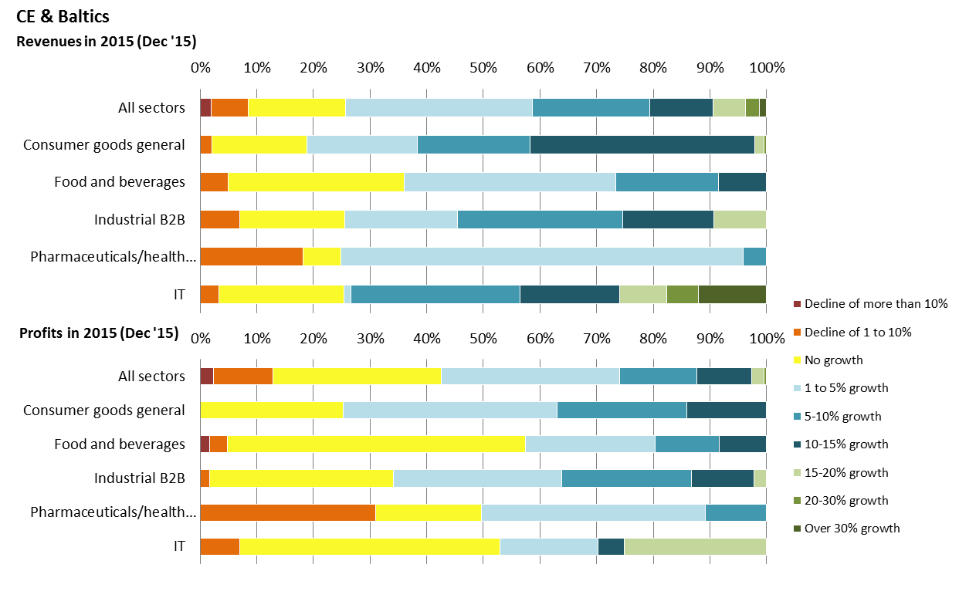
CE & Baltics aggregate
Latest estimates: revenue and profit results by sector, 2015
From our December 2015 survey

Slide 30
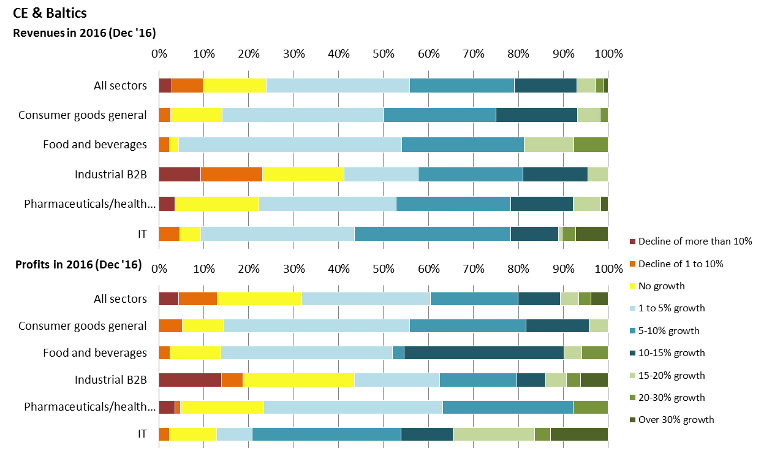
CE & Baltics aggregate
Latest forecasts: revenue and profit results by sector, 2016
From our December 2016 survey

Slide 31
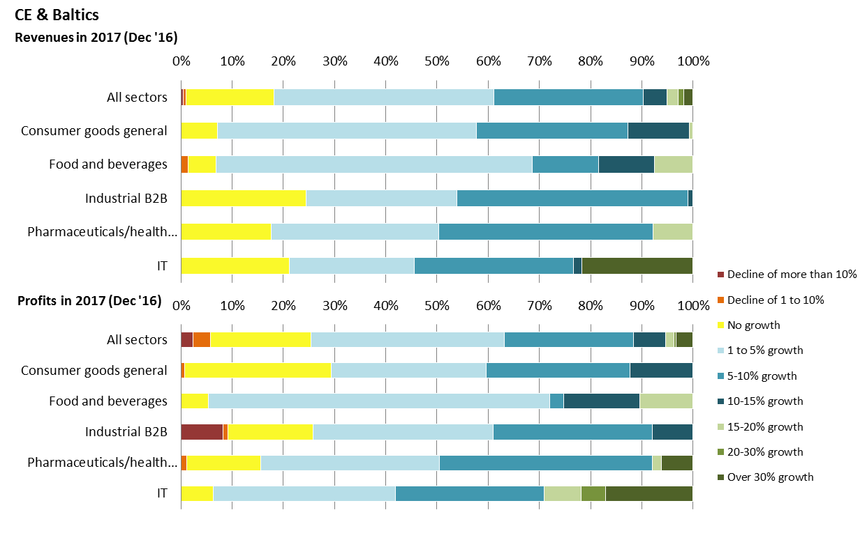
CE & Baltics aggregate
Latest forecasts: revenue and profit results by sector, 2017
From our December 2016 survey

Slide 32
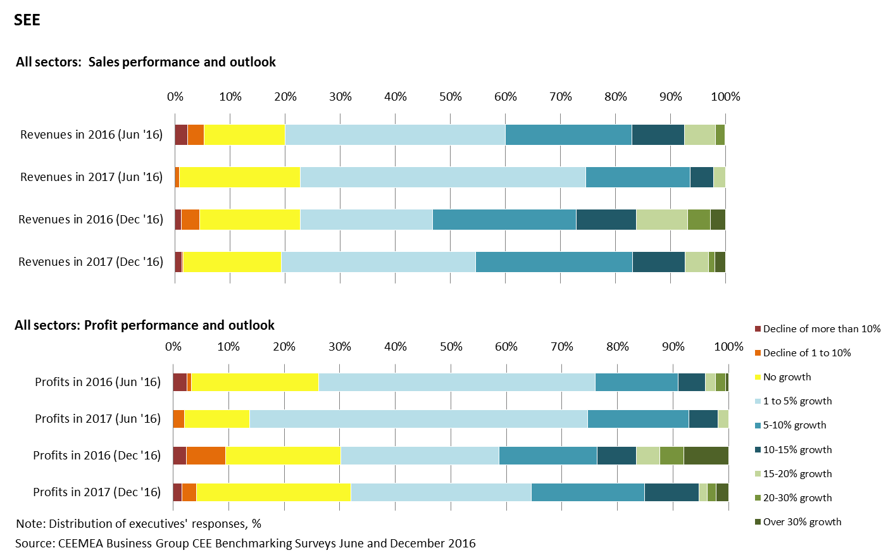
SEE aggregate
Corporate revenue and profit results and forecasts, 2016-17, all sectors
Comparison of our June and December 2016 surveys

Slide 33
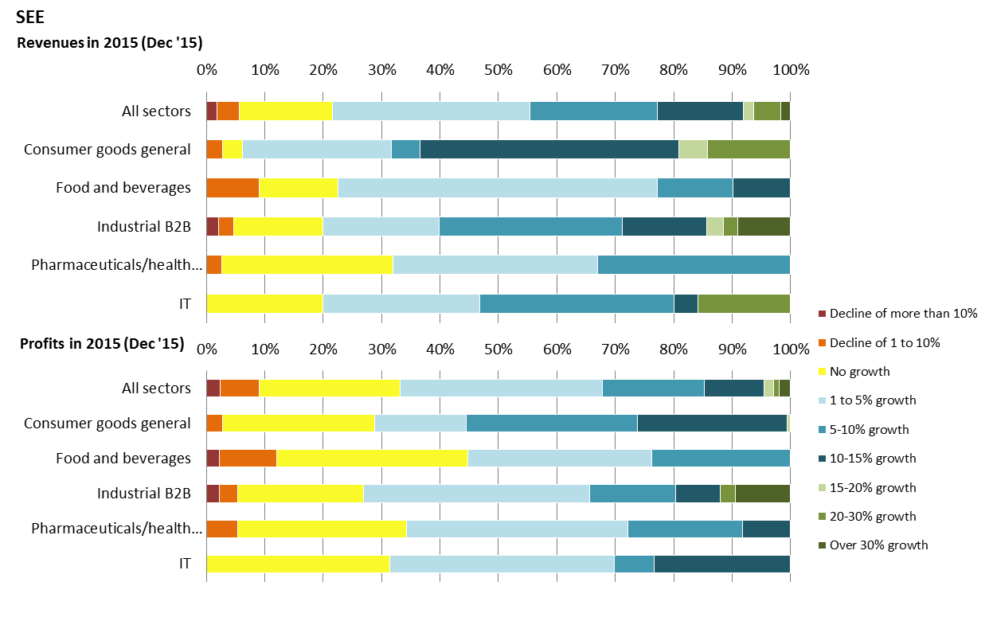
SEE aggregate
Latest estimates: revenue and profit results by sector, 2015
From our December 2015 survey

Slide 34
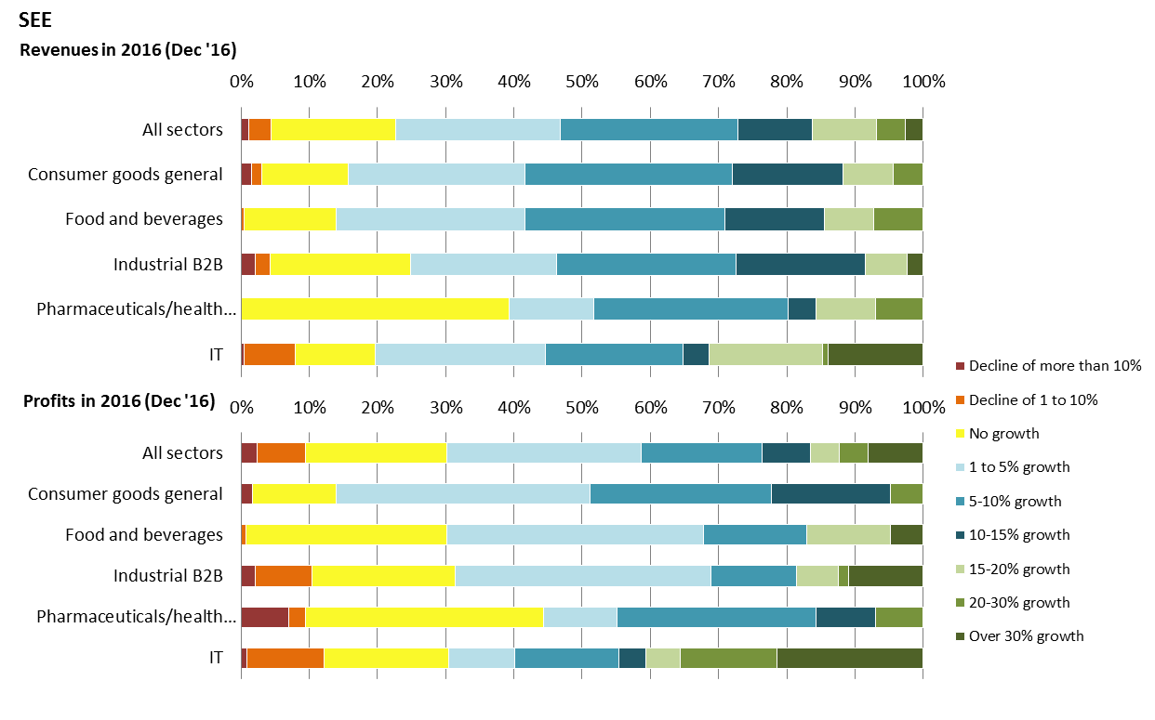
SEE aggregate
Latest forecasts: revenue and profit results by sector, 2016
From our December 2016 survey

Slide 35
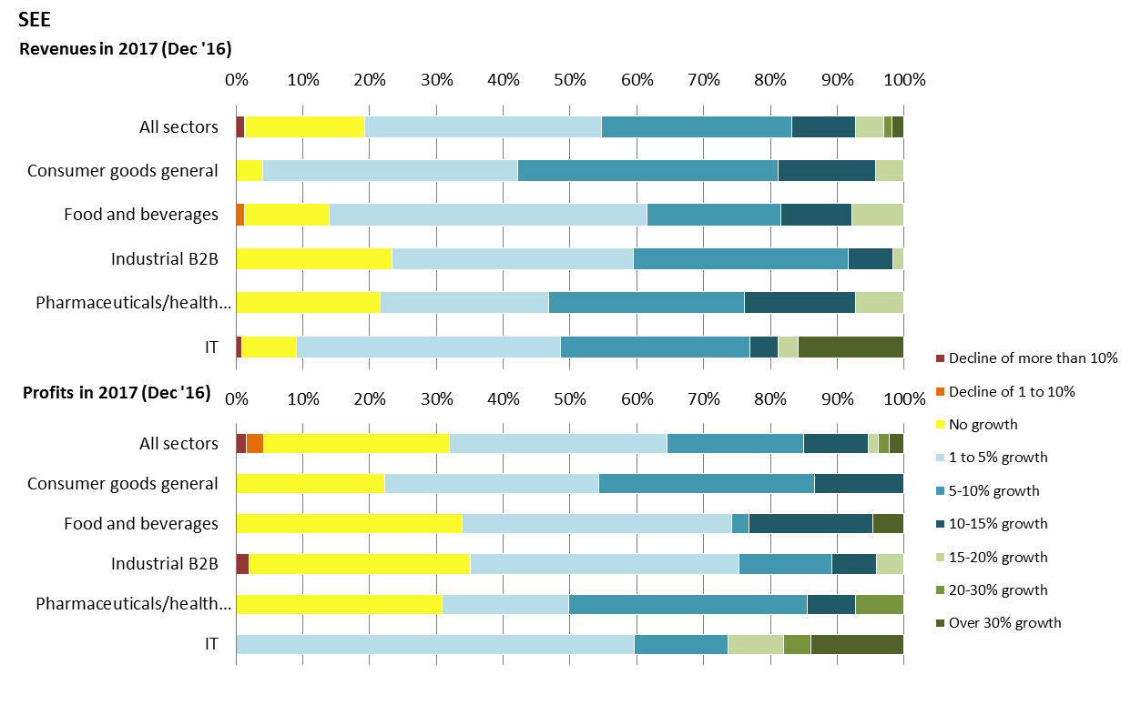
SEE aggregate
Latest forecasts: revenue and profit results by sector, 2017
From our December 2016 survey

Slide 36
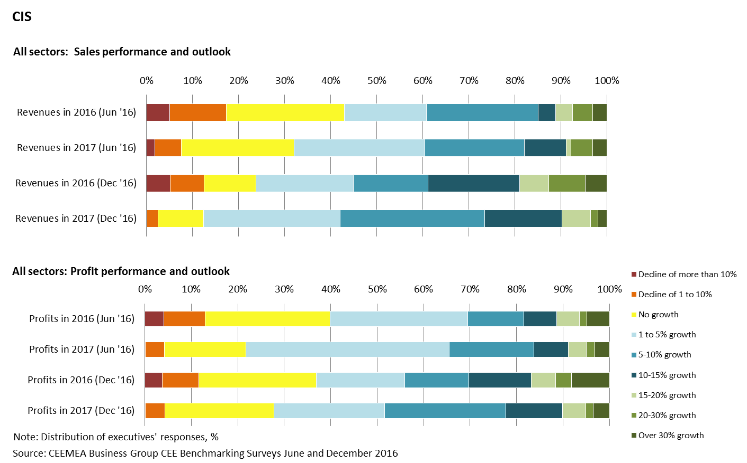
CIS aggregate
Corporate revenue and profit results and forecasts, 2016-17, all sectors
Comparison of our June and December 2016 surveys

Slide 37
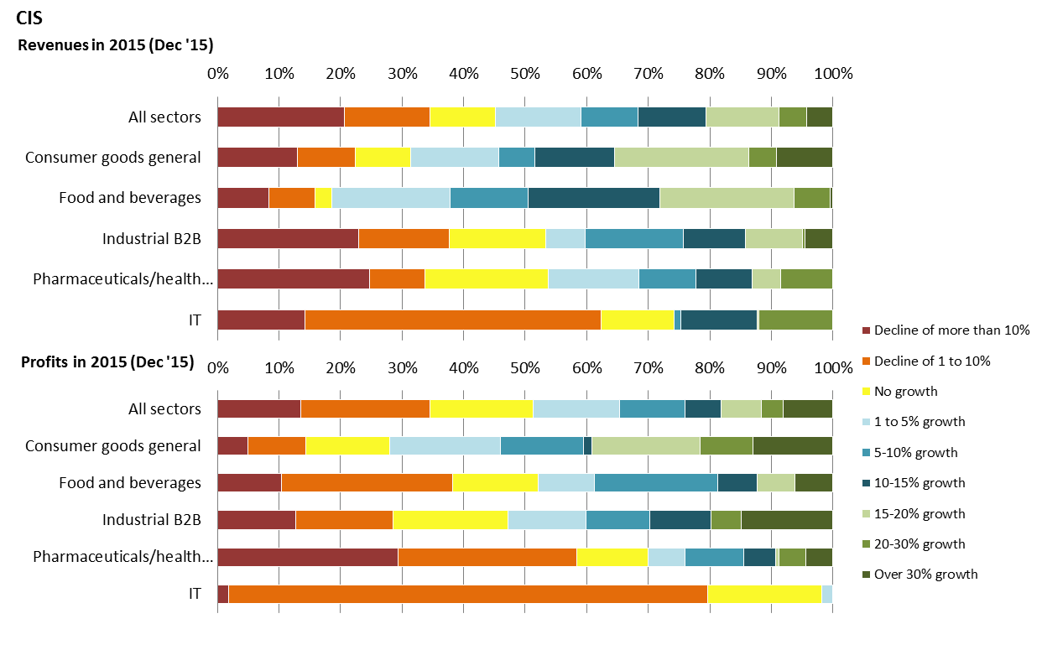
CIS aggregate
Latest estimates: revenue and profit results by sector, 2015
From our December 2015 survey

Slide 38
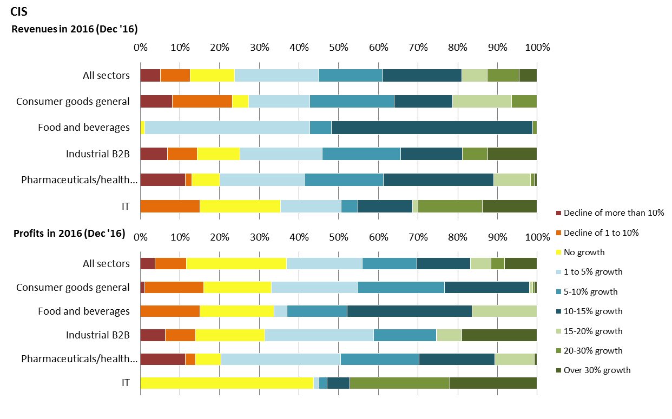
CIS aggregate
Latest forecasts: revenue and profit results by sector, 2016
From our December 2016 survey

Slide 39
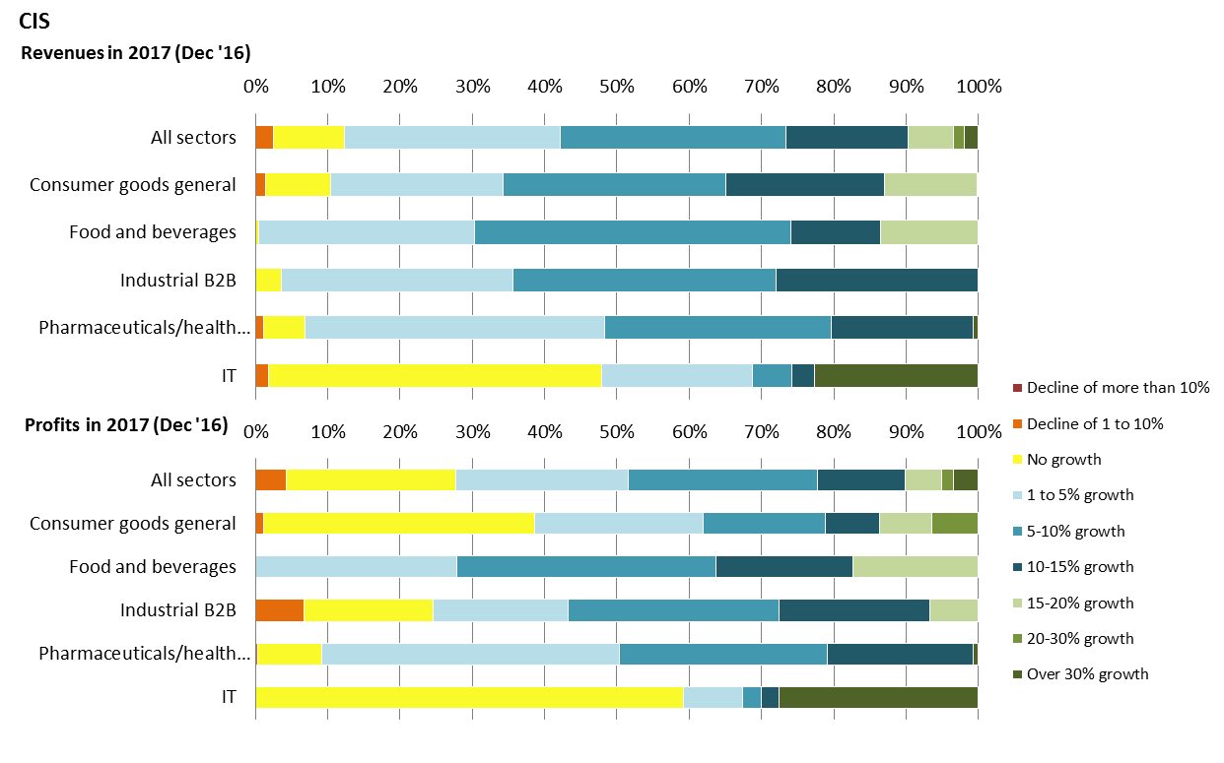
CIS aggregate
Latest forecasts: revenue and profit results by sector, 2017
From our December 2016 survey

Slide 40
Results by market
Note: missing series mean insufficient responses for that sector.

Slide 41
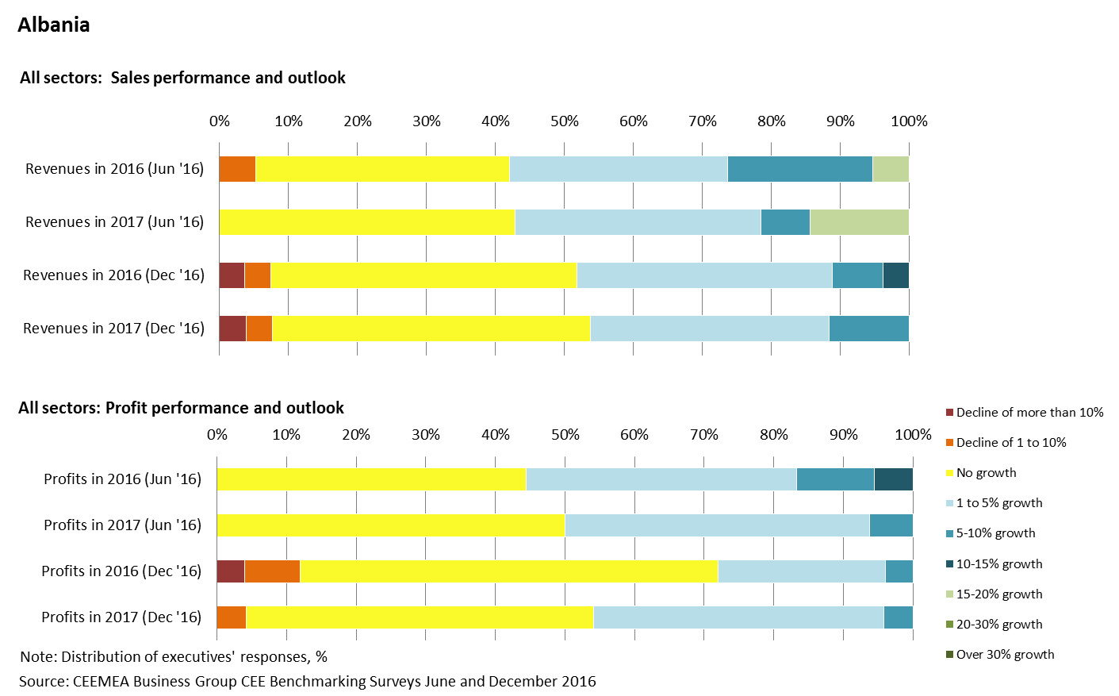
Albania
Corporate revenue and profit results and forecasts, 2016-17, all sectors
Comparison of our June and December 2016 surveys

Slide 42
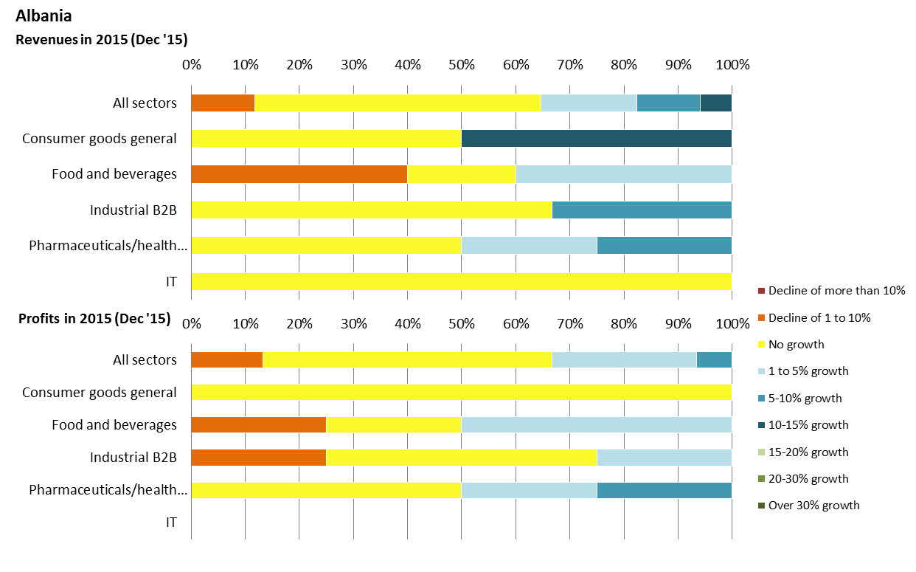
Albania
Latest estimates: revenue and profit results by sector, 2015
From our December 2015 survey

Slide 43
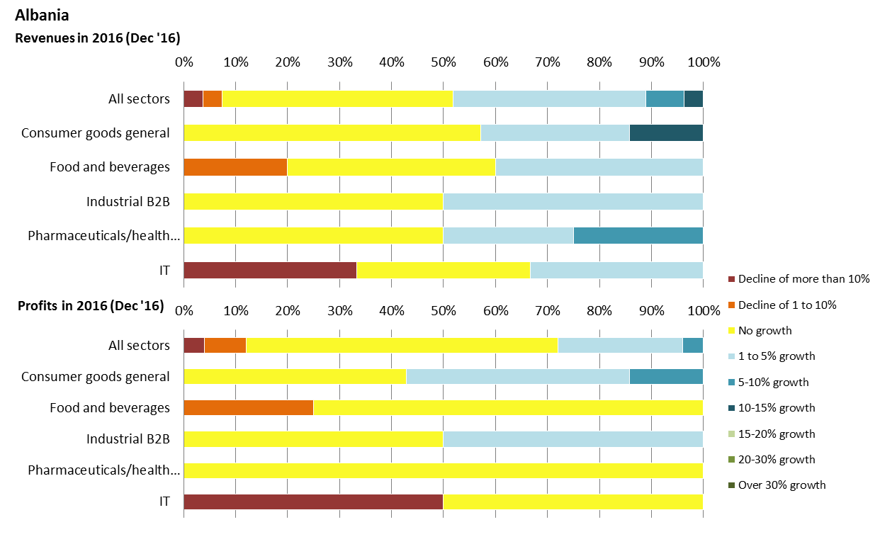
Albania
Latest forecasts: revenue and profit results by sector, 2016
From our December 2016 survey

Slide 44
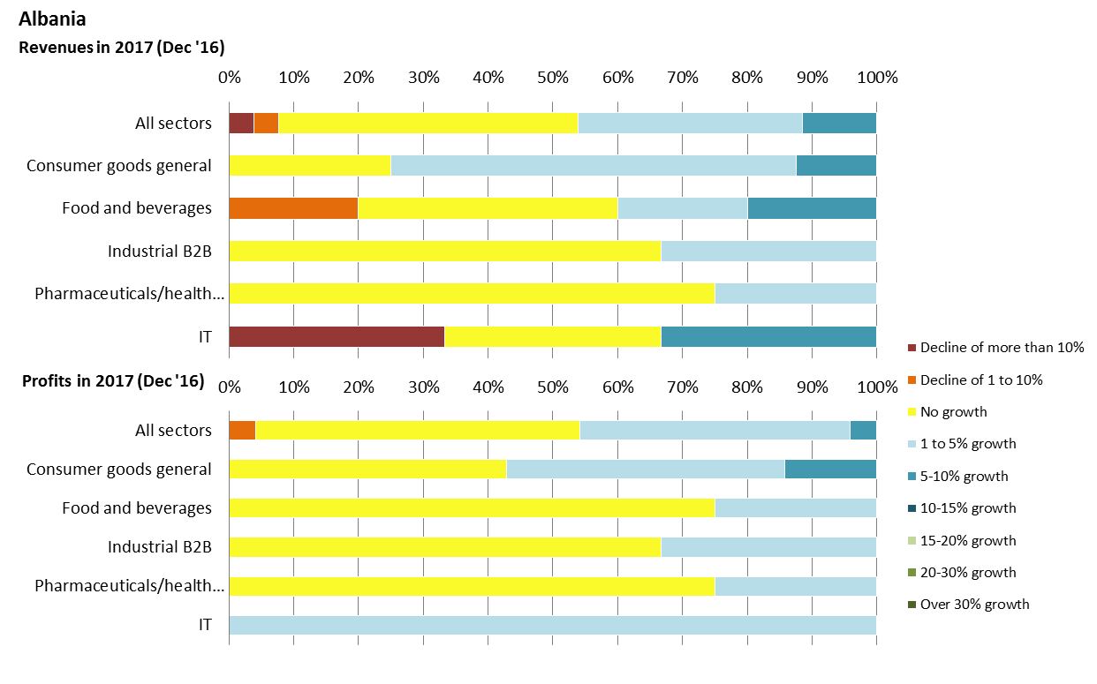
Albania
Latest forecasts: revenue and profit results by sector, 2017
From our December 2016 survey

Slide 45
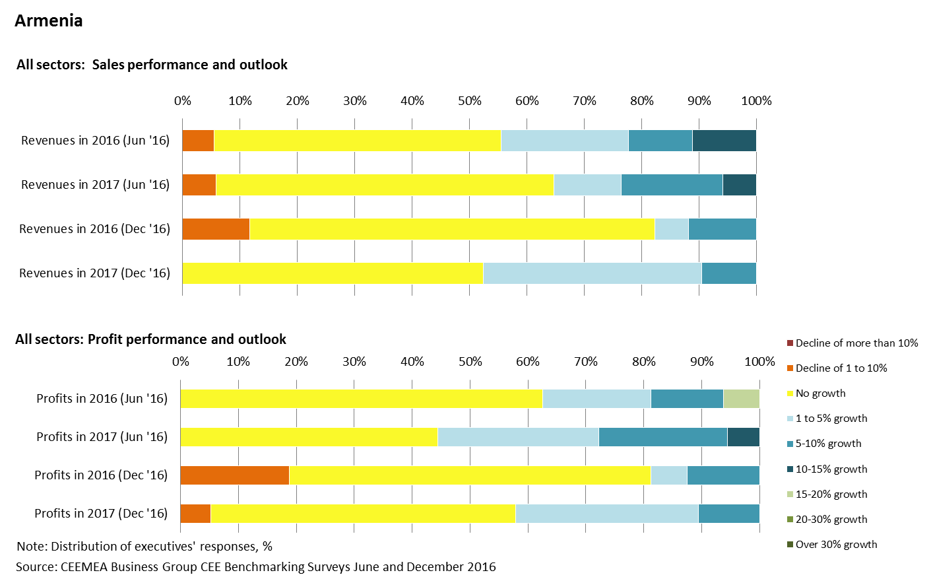
Armenia
Corporate revenue and profit results and forecasts, 2016-17, all sectors
Comparison of our June and December 2016 surveys

Slide 46
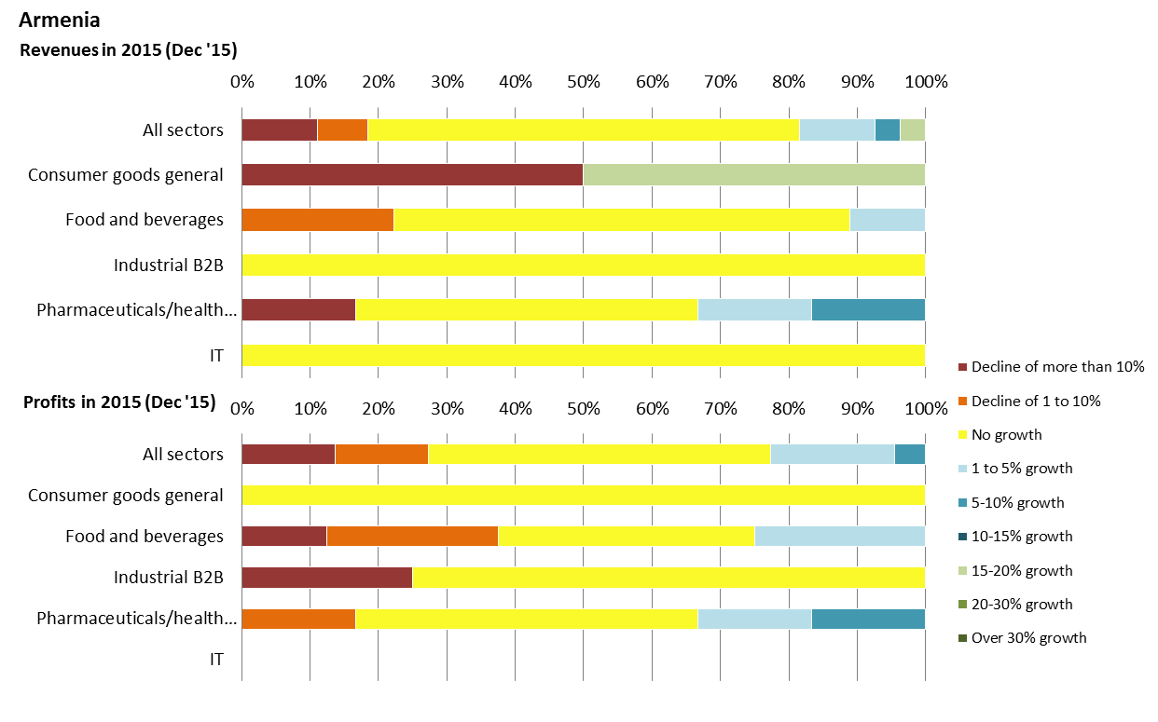
Armenia
Latest estimates: revenue and profit results by sector, 2015
From our December 2015 survey

Slide 47
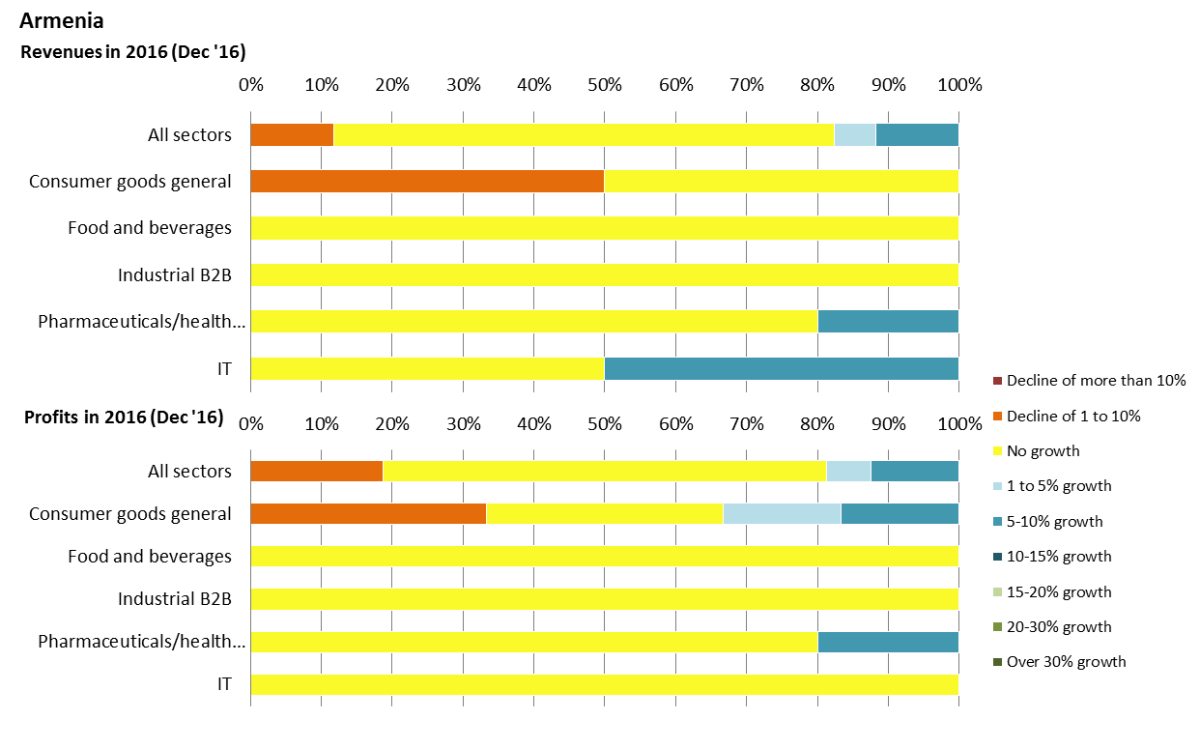
Armenia
Latest forecasts: revenue and profit results by sector, 2016
From our December 2016 survey

Slide 48
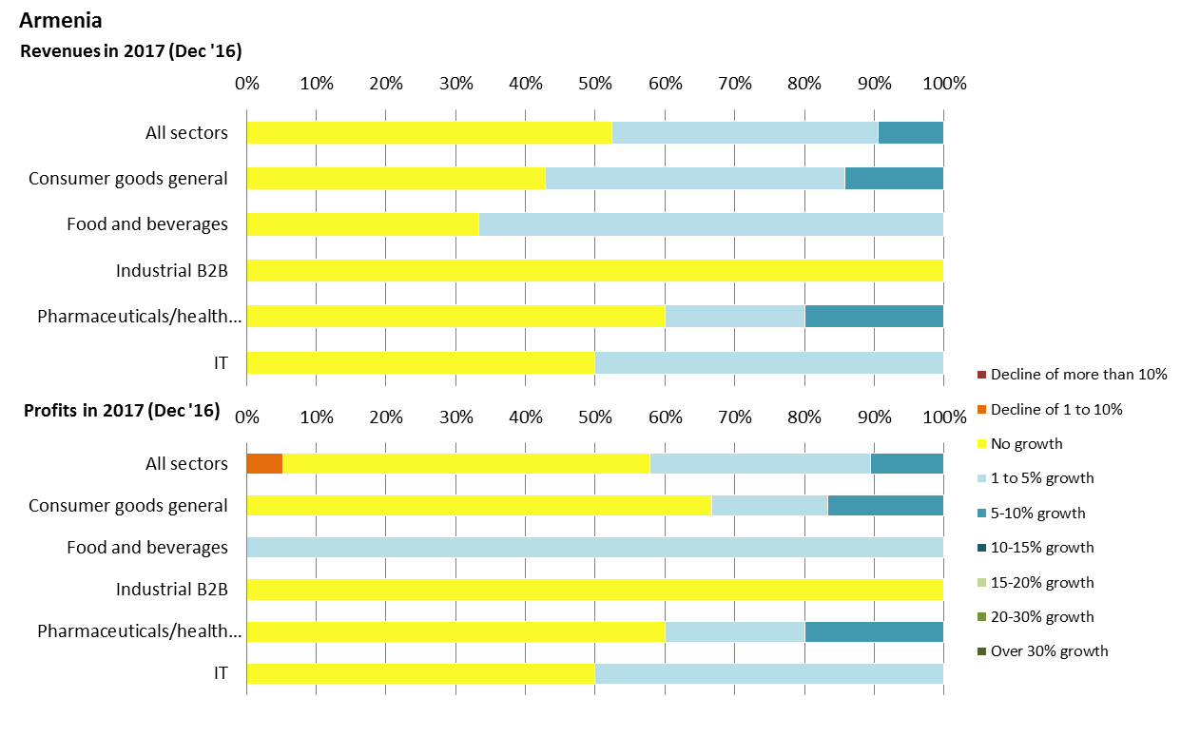
Armenia
Latest forecasts: revenue and profit results by sector, 2017
From our December 2016 survey

Slide 49
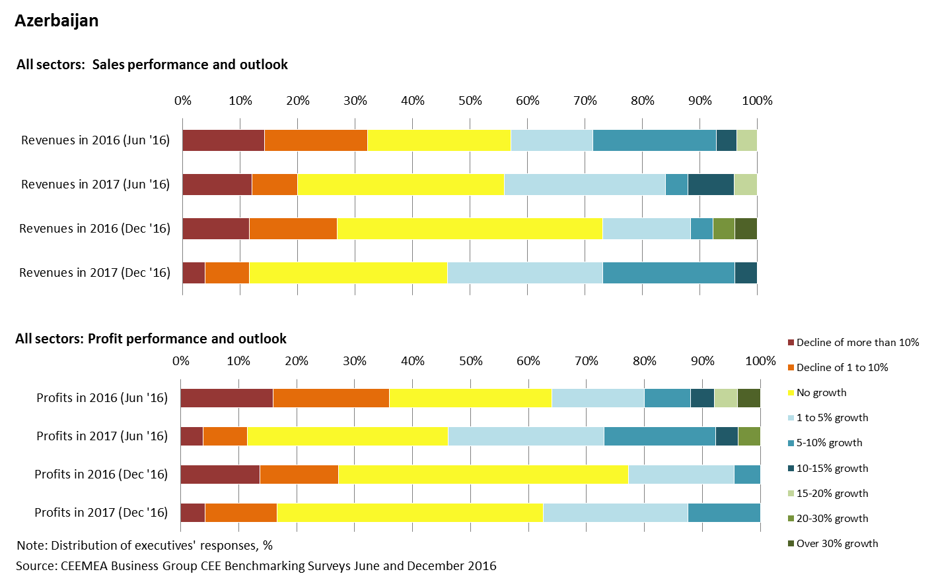
Azerbaijan
Corporate revenue and profit results and forecasts, 2016-17, all sectors
Comparison of our June and December 2016 surveys

Slide 50
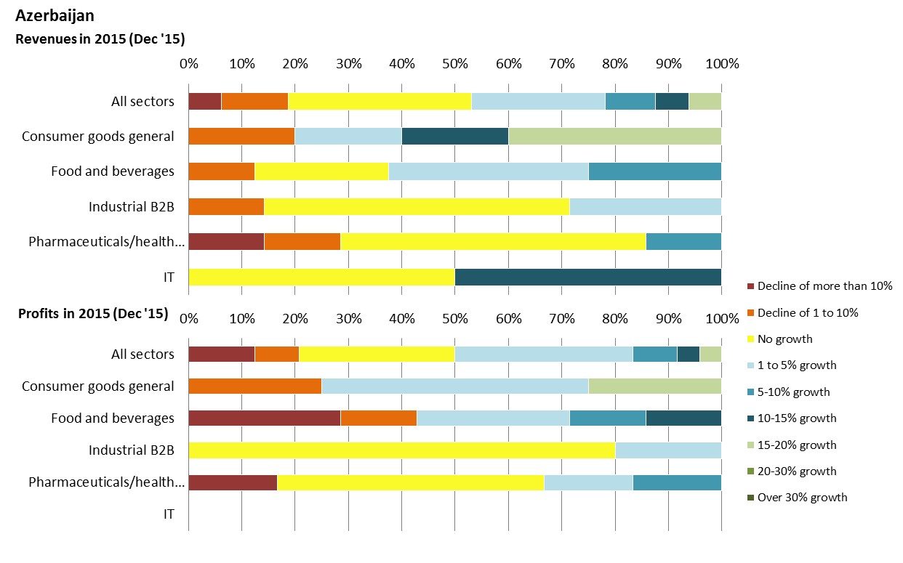
Azerbaijan
Latest estimates: revenue and profit results by sector, 2015
From our December 2015 survey

Slide 51
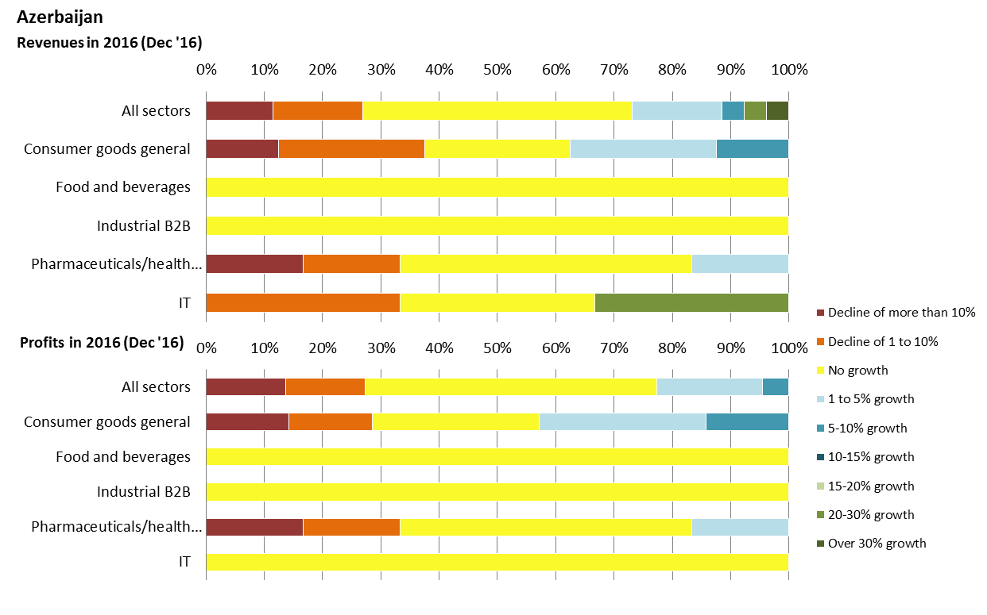
Azerbaijan
Latest forecasts: revenue and profit results by sector, 2016
From our December 2016 survey

Slide 52
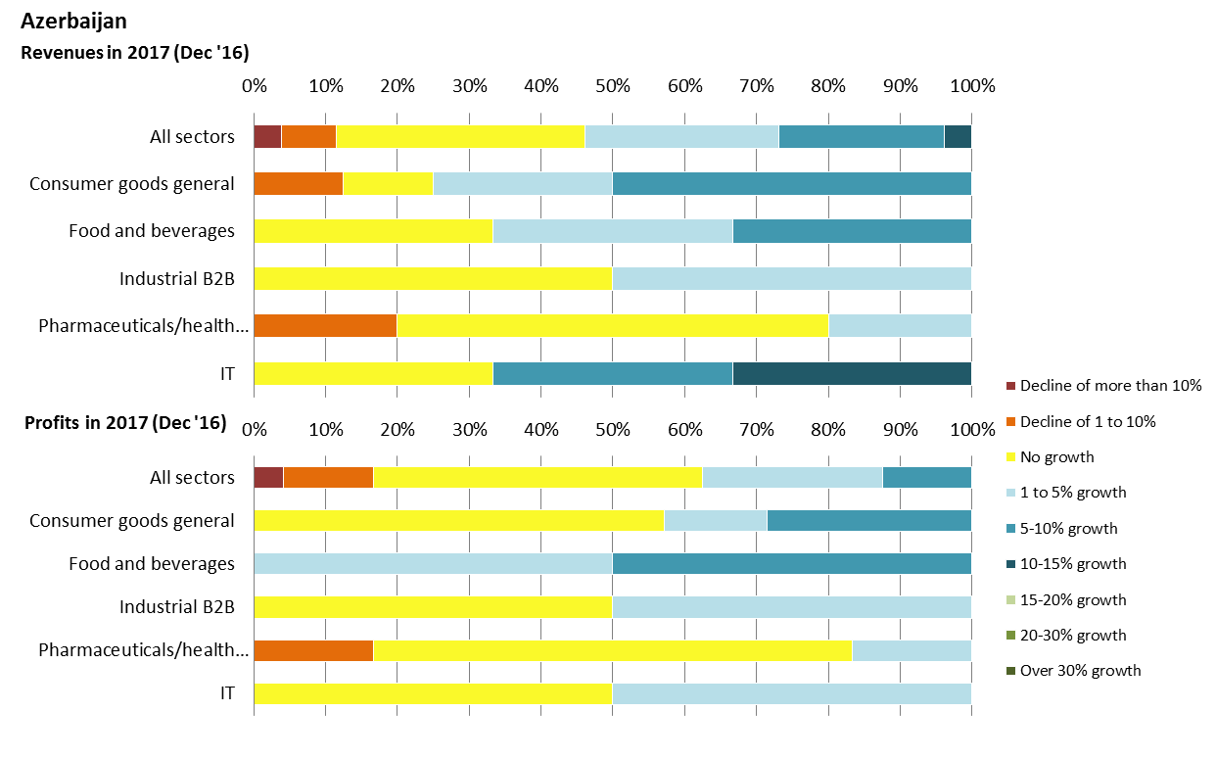
Azerbaijan
Latest forecasts: revenue and profit results by sector, 2017
From our December 2016 survey

Slide 53
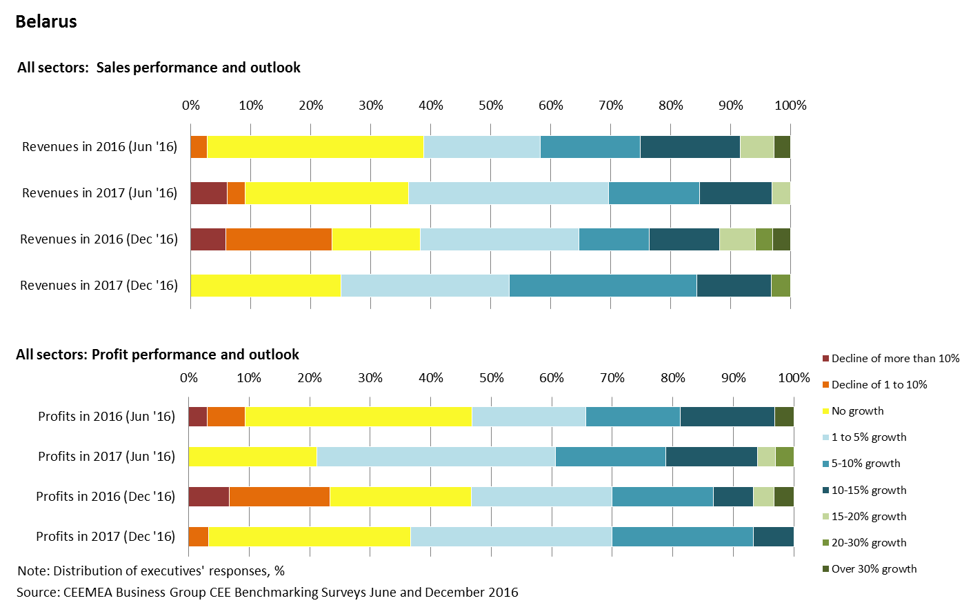
Belarus
Corporate revenue and profit results and forecasts, 2016-17, all sectors
Comparison of our June and December 2016 surveys

Slide 54

Belarus
Latest estimates: revenue and profit results by sector, 2015
From our December 2015 survey

Slide 55

Belarus
Latest forecasts: revenue and profit results by sector, 2016
From our December 2016 survey

Slide 56

Belarus
Latest forecasts: revenue and profit results by sector, 2017
From our December 2016 survey

Slide 57

Bosnia-Hercegovina
Corporate revenue and profit results and forecasts, 2016-17, all sectors
Comparison of our June and December 2016 surveys

Slide 58

Bosnia-Hercegovina
Latest estimates: revenue and profit results by sector, 2015
From our December 2015 survey

Slide 59

Bosnia-Hercegovina
Latest forecasts: revenue and profit results by sector, 2016
From our December 2016 survey

Slide 60

Bosnia-Hercegovina
Latest forecasts: revenue and profit results by sector, 2017
From our December 2016 survey

Slide 61

Bulgaria
Corporate revenue and profit results and forecasts, 2016-17, all sectors
Comparison of our June and December 2016 surveys

Slide 62

Bulgaria
Latest estimates: revenue and profit results by sector, 2015
From our December 2015 survey

Slide 63

Bulgaria
Latest forecasts: revenue and profit results by sector, 2016
From our December 2016 survey

Slide 64

Bulgaria
Latest forecasts: revenue and profit results by sector, 2017
From our December 2016 survey

Slide 65

Croatia
Corporate revenue and profit results and forecasts, 2016-17, all sectors
Comparison of our June and December 2016 surveys

Slide 66

Croatia
Latest estimates: revenue and profit results by sector, 2015
From our December 2015 survey

Slide 67

Croatia
Latest forecasts: revenue and profit results by sector, 2016
From our December 2016 survey

Slide 68

Croatia
Latest forecasts: revenue and profit results by sector, 2017
From our December 2016 survey

Slide 69

Czech Republic
Corporate revenue and profit results and forecasts, 2016-17, all sectors
Comparison of our June and December 2016 surveys

Slide 70

Czech Republic
Latest estimates: revenue and profit results by sector, 2015
From our December 2015 survey

Slide 71

Czech Republic
Latest forecasts: revenue and profit results by sector, 2016
From our December 2016 survey

Slide 72

Czech Republic
Latest forecasts: revenue and profit results by sector, 2017
From our December 2016 survey

Slide 73

Estonia
Corporate revenue and profit results and forecasts, 2016-17, all sectors
Comparison of our June and December 2016 surveys

Slide 74

Estonia
Latest estimates: revenue and profit results by sector, 2015
From our December 2015 survey

Slide 75

Estonia
Latest forecasts: revenue and profit results by sector, 2016
From our December 2016 survey

Slide 76

Estonia
Latest forecasts: revenue and profit results by sector, 2017
From our December 2016 survey

Slide 77

Georgia
Corporate revenue and profit results and forecasts, 2016-17, all sectors
Comparison of our June and December 2016 surveys

Slide 78

Georgia
Latest estimates: revenue and profit results by sector, 2015
From our December 2015 survey

Slide 79

Georgia
Latest forecasts: revenue and profit results by sector, 2016
From our December 2016 survey

Slide 80

Georgia
Latest forecasts: revenue and profit results by sector, 2017
From our December 2016 survey

Slide 81

Hungary
Corporate revenue and profit results and forecasts, 2016-17, all sectors
Comparison of our June and December 2016 surveys

Slide 82

Hungary
Latest estimates: revenue and profit results by sector, 2015
From our December 2015 survey

Slide 83

Hungary
Latest forecasts: revenue and profit results by sector, 2016
From our December 2016 survey

Slide 84

Hungary
Latest forecasts: revenue and profit results by sector, 2017
From our December 2016 survey

Slide 85

Kazakhstan
Corporate revenue and profit results and forecasts, 2016-17, all sectors
Comparison of our June and December 2016 surveys

Slide 86

Kazakhstan
Latest estimates: revenue and profit results by sector, 2015
From our December 2015 survey

Slide 87

Kazakhstan
Latest forecasts: revenue and profit results by sector, 2016
From our December 2016 survey

Slide 88

Kazakhstan
Latest forecasts: revenue and profit results by sector, 2017
From our December 2016 survey

Slide 89

Latvia
Corporate revenue and profit results and forecasts, 2016-17, all sectors
Comparison of our June and December 2016 surveys

Slide 90

Latvia
Latest estimates: revenue and profit results by sector, 2015
From our December 2015 survey

Slide 91

Latvia
Latest forecasts: revenue and profit results by sector, 2016
From our December 2016 survey

Slide 92

Latvia
Latest forecasts: revenue and profit results by sector, 2017
From our December 2016 survey

Slide 93

Lithuania
Corporate revenue and profit results and forecasts, 2016-17, all sectors
Comparison of our June and December 2016 surveys

Slide 94

Lithuania
Latest estimates: revenue and profit results by sector, 2015
From our December 2015 survey

Slide 95

Lithuania
Latest forecasts: revenue and profit results by sector, 2016
From our December 2016 survey

Slide 96

Lithuania
Latest forecasts: revenue and profit results by sector, 2017
From our December 2016 survey

Slide 97

Macedonia
Corporate revenue and profit results and forecasts, 2016-17, all sectors
Comparison of our June and December 2016 surveys

Slide 98

Macedonia
Latest estimates: revenue and profit results by sector, 2015
From our December 2015 survey

Slide 99

Macedonia
Latest forecasts: revenue and profit results by sector, 2016
From our December 2016 survey

Slide 100

Macedonia
Latest forecasts: revenue and profit results by sector, 2017
From our December 2016 survey

Slide 101

Poland
Corporate revenue and profit results and forecasts, 2016-17, all sectors
Comparison of our June and December 2016 surveys

Slide 102

Poland
Latest estimates: revenue and profit results by sector, 2015
From our December 2015 survey

Slide 103

Poland
Latest forecasts: revenue and profit results by sector, 2016
From our December 2016 survey

Slide 104

Poland
Latest forecasts: revenue and profit results by sector, 2017
From our December 2016 survey

Slide 105

Romania
Corporate revenue and profit results and forecasts, 2016-17, all sectors
Comparison of our June and December 2016 surveys

Slide 106

Romania
Latest estimates: revenue and profit results by sector, 2015
From our December 2015 survey

Slide 107

Romania
Latest forecasts: revenue and profit results by sector, 2016
From our December 2016 survey

Slide 108

Romania
Latest forecasts: revenue and profit results by sector, 2017
From our December 2016 survey

Slide 109

Russia
Corporate revenue and profit results and forecasts, 2016-17, all sectors
Comparison of our June and December 2016 surveys

Slide 110

Russia
Latest estimates: revenue and profit results by sector, 2015
From our December 2015 survey

Slide 111

Russia
Latest forecasts: revenue and profit results by sector, 2016
From our December 2016 survey

Slide 112

Russia
Latest forecasts: revenue and profit results by sector, 2017
From our December 2016 survey

Slide 113

Serbia
Corporate revenue and profit results and forecasts, 2016-17, all sectors
Comparison of our June and December 2016 surveys

Slide 114

Serbia
Latest estimates: revenue and profit results by sector, 2015
From our December 2015 survey

Slide 115

Serbia
Latest forecasts: revenue and profit results by sector, 2016
From our December 2016 survey

Slide 116

Serbia
Latest forecasts: revenue and profit results by sector, 2017
From our December 2016 survey

Slide 117

Slovakia
Corporate revenue and profit results and forecasts, 2016-17, all sectors
Comparison of our June and December 2016 surveys

Slide 118

Slovakia
Latest estimates: revenue and profit results by sector, 2015
From our December 2015 survey

Slide 119

Slovakia
Latest forecasts: revenue and profit results by sector, 2016
From our December 2016 survey

Slide 120

Slovakia
Latest forecasts: revenue and profit results by sector, 2017
From our December 2016 survey

Slide 121

Slovenia
Corporate revenue and profit results and forecasts, 2016-17, all sectors
Comparison of our June and December 2016 surveys

Slide 122

Slovenia
Latest estimates: revenue and profit results by sector, 2015
From our December 2015 survey

Slide 123

Slovenia
Latest forecasts: revenue and profit results by sector, 2016
From our December 2016 survey

Slide 124

Slovenia
Latest forecasts: revenue and profit results by sector, 2017
From our December 2016 survey

Slide 125

Turkey
Corporate revenue and profit results and forecasts, 2016-17, all sectors
Comparison of our June and December 2016 surveys

Slide 126

Turkey
Latest estimates: revenue and profit results by sector, 2015
From our December 2015 survey

Slide 127

Turkey
Latest forecasts: revenue and profit results by sector, 2016
From our December 2016 survey

Slide 128

Turkey
Latest forecasts: revenue and profit results by sector, 2017
From our December 2016 survey

Slide 129

Ukraine
Corporate revenue and profit results and forecasts, 2016-17, all sectors
Comparison of our June and December 2016 surveys

Slide 130

Ukraine
Latest estimates: revenue and profit results by sector, 2015
From our December 2015 survey

Slide 131

Ukraine
Latest forecasts: revenue and profit results by sector, 2016
From our December 2016 survey

Slide 132

Ukraine
Latest forecasts: revenue and profit results by sector, 2017
From our December 2016 survey

Slide 133
Disclaimer, copyright, sources
© 2016 CEEMEA Business Group
CEEMEA Business Group currently works with senior leaders of over 430 large multinational companies operating in the Central Eastern Europe, Middle East and Africa regions, helping them understand economic and business outlooks globally, regionally and at country levels. Regional and global executives also receive regular advice and updates on best practices for expansion and success in emerging markets. Executive members of the CEEMEA Business Group can also attend regular peer group meetings held throughout Europe and in Dubai.
Source: DT-Global Business Consulting GmbH and CEEMEA Business Group research
Basic data sources come from central banks, own intelligence network, CEEMEA Business Group corporate survey, governments and other public sources. Interpretation, views, forecasts, business quotes and business outlooks by DT-Global Business Consulting GmbH and CEEMEA Business Group.
This material is provided for information purposes only. It is not a recommendation or advice of any investment or commercial activity whatsoever. The CEEMEA Business Group accepts no liability for any commercial losses incurred by any party acting on information in these materials.
Contact: Dr Daniel Thorniley, President, DT-Global Business Consulting GmbH
M: +43 676 534 685 / E: danielthorniley@dt-gbc.com

