Slide 1

Russia and CIS Economic statistics for your business planning
by Dr Daniel Thorniley
19 September 2016

Slide 2
Central Scenario - 2017 economic outlook
(oil averages $46-55)
GDP | 1.3%
Inflation (year-end) | 5.5%
Inflation (average) | 6.2%
Consumer spending | 1.6%
Investment | 2.2%
Industrial output | 1.7%
Rouble to US dollar average | 64-69
Rouble to the Euro average | 72-77

Slide 3
Economic scenarios and the rouble for 2017 at different oil prices
Average oil price 2016 | GDP | Inflation average | Rouble/US$ | Rouble/€
 |  |  | Average
$80-85 | 3.3% | 5.4% | 45-52 | 52-58
$70-80 | 2.8% | 5.4% | 52-57 | 58-64
$60-70 | 2.4% | 5.8% | 57-60 | 64-66
$55-60 | 1.8% | 6.1% | 60-63 | 66-69
$50-55 | 1.3% | 6.3% | 62-67 | 69-73
$45-50 | 0.3% | 7.5% | 64-69 | 72-77
$35-45 | -1.3% | 8.2% | 63-69 | 74-78
$25-35 | -2.5% | 11.5% | 80-84 | 86-92

Slide 4
Macro-economic indicators 2009-2020
 | 2009 | 2010 | 2011 | 2012 | 2013 | 2014 | 2015 | 2016 | 2017 | 2018 | 2019 | 2020
GDP | -7,9 | 4,3 | 4,3 | 3,4 | 1,3 | 0.6 | -3,8 | -0,7 | 1,4 | 1,8 | 1,9 | 2,0
Retail sales | -5,5 | 6,3 | 7,2 | 5,7 | 3,9 | 2,5 | -8,8 | -3,5 | 2 | 2,6 | 2,8 | 2,9
Household spending | -7,6 | 5,5 | 6,8 | 7,9 | 4,7 | 1,8 | -8,5 | -2,6 | 1,8 | 2,6 | 2,6 | 2,8
Real wages | -2,8 | 4,4 | 4,9 | 8,2 | 5,2 | 1,9 | -9,2 | -1,3 | 2,2 | 2,7 | 2,9 | 3,2
Disposable income | 1,0 | 3,7 | 2,8 | 3,7 | 3,3 | 2,1 | -4,0 | -2,5 | 1,8 | 2,2 | 2,6 | 2,7
Inflation (year-end) | 8,8 | 8,7 | 6,1 | 6,6 | 6,5 | 11,4 | 12,9 | 6,3 | 5,5 | 5,3 | 5,2 | 5,0
Unemployment rate | 7,9 | 7,6 | 6,5 | 5,3 | 5,5 | 5,3 | 5,4 | 5,8 | 5,6 | 5,5 | 5,4 | 5,2
Gross fixed investment | -17,9 | 5,6 | 9,8 | 6,0 | -0,3 | -4,8 | -7,6 | -3,7 | 2,2 | 3,4 | 3,6 | 3,9
Industrial output | -10,8 | 8,3 | 4,7 | 2,6 | 0,3 | 1,1 | -3,4 | 0,2 | 1,7 | 2,5 | 3,1 | 3,3
FX reserves ($bn) year-end | 447 | 485 | 510 | 528 | 509 | 385 | 365 | 410 | 390 | 400 | 415,0 | 420,0
Rouble/$ (year-end) | 30,3 | 30,4 | 32,1 | 30,4 | 32,9 | 58,0 | 73,0 | 68,0 | 71,0 | 76,0 | 78,0 | 79,0
Rouble/Euro (year-end) | 43,4 | 40,0 | 41,5 | 40,1 | 45,1 | 72,0 | 78,0 | 74,0 | 77,0 | 82,0 | 84,0 | 84,0
Budget balance (% of GDP) | -6,3 | -3,5 | -0,2 | 0,0 | -0,5 | -0,5 | -3,6 | -4,1 | -3,2 | -2,6 | -2,2 | -1,8
Current-account balance (% of GDP) | 3,8 | 4,9 | 4,9 | 3,6 | 1,6 | 2,7 | 4,3 | 4,1 | 3,8 | 3,2 | 2,5 | 1,9

Slide 5
Key statistics by year and monthly

Slide 6
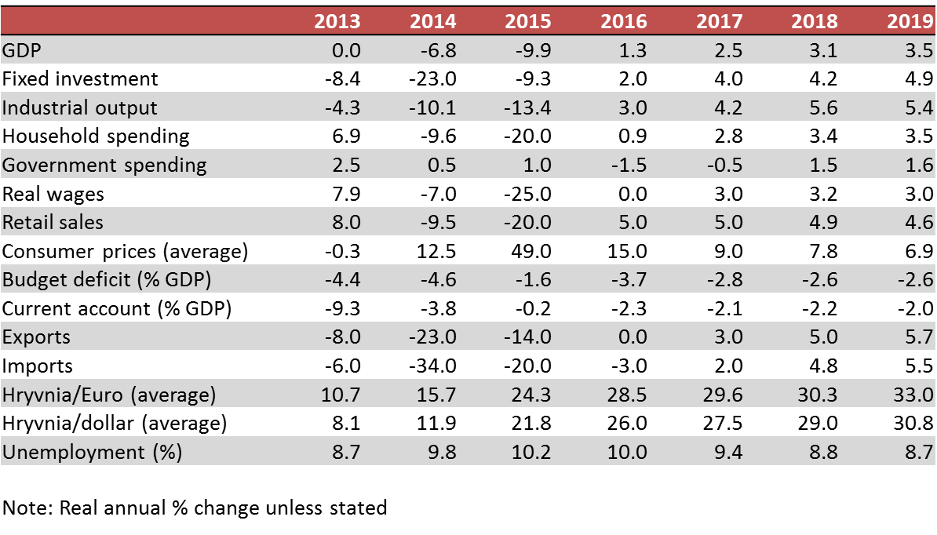
Ukraine - economic outlook: statistics

Slide 7
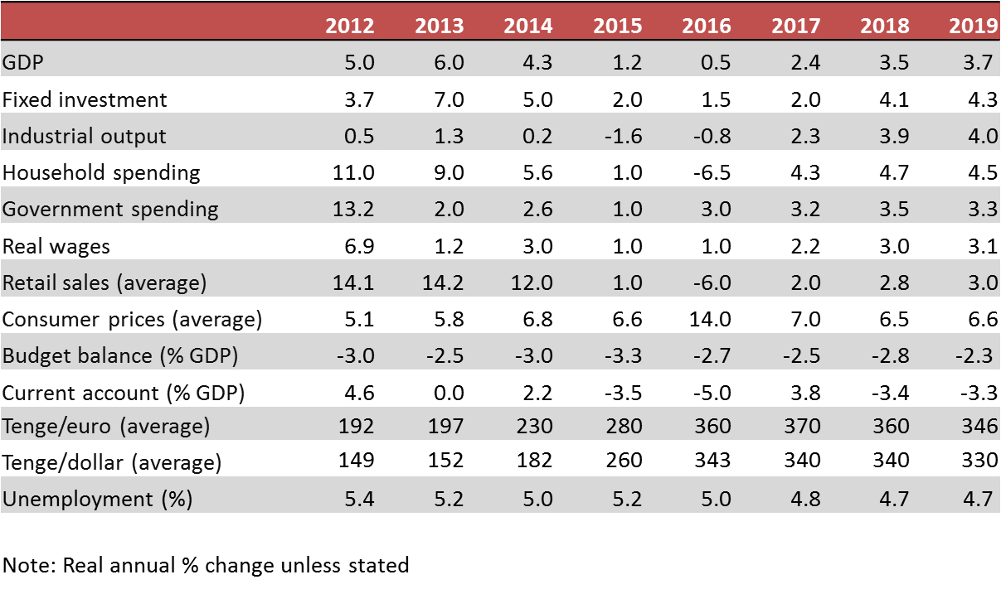
Kazakhstan - economic outlook: statistics

Slide 8
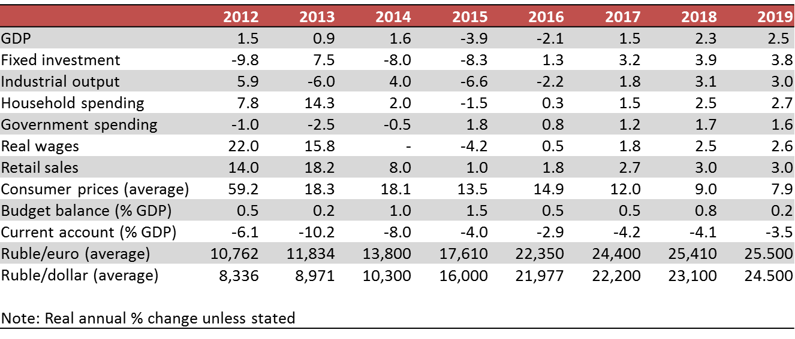
Belarus - economic outlook: statistics

Slide 9
Disclaimer, copyright, sources
© 2016 DT Global Business Consulting GmbH
DT-Global Business Consulting GmbH
Address: Keinergasse 8/33, 1030 Vienna, Austria,
Company registration: FN 331137t
Source:
DT Global Business Consulting GmbH. This material is provided for information purposes only. It is not a recommendation or advice of any investment or commercial activity whatsoever. DT Global Business Consulting GmbH accepts no liability for any commercial losses incurred by any party acting on information in these materials.
Contact:
Dr Daniel Thorniley, President,
DT Global Business Consulting GmbH,
E: danielthorniley@dt-gbc.com

