Slide 1
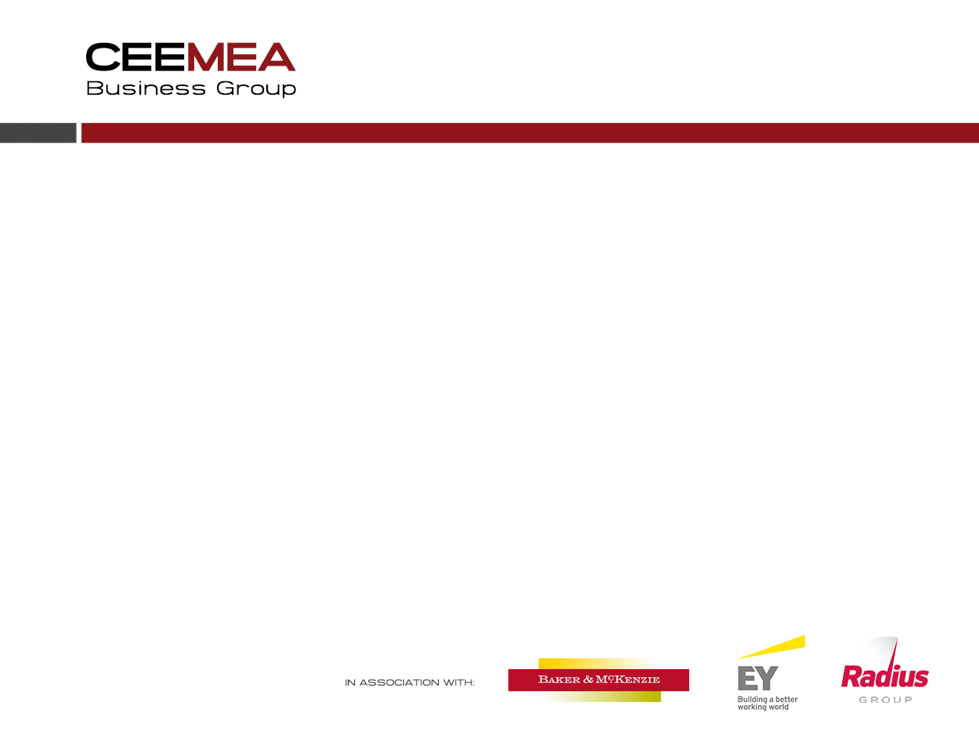
Ukraine
Business outlook 2014-18
Quarterly update – January 2015
by Dr Daniel Thorniley

Slide 2
Content
Executive summary
Some assumptions
Key factors
Business outlook
What are companies thinking and doing?
What are Ukrainian companies saying?
Business features
Human resources and salaries
Bad blood?
Where do you put Ukraine in your structure?
Economic outlook
Currency and inflation issues and outlook
Corporate sales and profit 2014-15 (survey results)
Ukraine - statistics

Slide 3
Executive summary (1)
We presume there will be no further military escalation and that the Ukraine-Russia conflict will settle into a messy, nasty frozen conflict that does harm to both countries and especially to Ukraine
Most risk are to the downside but the Russian economic crisis may make the Russian negotiators more moderate. They now need a deal just as much as the Ukrainians
If there is further compromise militarily, then there is even some quick positive upside possible on the FX rate which would run though positively into business results
Maybe the political and military outlook is stable or better (maybe) BUT the economy is now experiencing the deeper negative impacts from the 2014 crisis year and recession is kicking in deeper now with soaring inflation
The start of 2015 is going to be bleak for the Ukrainian economy (and also in Russia)
But the short-term outlook is fixed and the existing negatives will affect the economy and business at least for the next 4-5 months no matter what happens
In the middle case scenario we see sharp negative growth last year (2104) very close to our earlier predictions of 7.3% with GDP this year still negative at -2.6%

Slide 4
Executive summary (2)
Economic recovery ought to kick-in late autumn this year with positive GDP of about 3.0% in 2016
If politics and military situation stabilises and improves and if IMF/EU financing continues, then the bounce-back could be accelerated by a few months and the jump in GDP growth in 2016 could rise as much as 5-6%. We then see GDP trending at 5-6% in 2017-2020
The gas transfer deal agreed last October and that was at least one positive step forward in Ukrainian-Russia relations with brokerage of the deal by the EU. The agreed price structure was very close to what we predicted in the early autumn—there were few surprises actually
Escalating “mini’ trade wars/sanctions will again just harm both markets and economies depending on the scale of such trade conflicts
It is important to note that executives in our Surveys do not expect or budget for any strong bounce back in 2015

Slide 5
Executive summary (3)
Ukraine will be the worst performing market in the CEE and Ceemea region for sales and profits in 2015 and one of the worst in 2016 although the second half of 2016 ought to see business recovery
Plans and forecasts are rightly very conservative. One should plan for an economic and business recovery starting very slowly in autumn 2015 and picking up through 2016
As we predicted, average inflation in 2014 was relatively “low” at 13.0% because of the very slow start in the first quarter of 2014 but the trend is sharply negative with inflation at 24.8% in December
We see inflation starting very high this year at 25-30% as the run-through from the hryvnia continues and FX reserves are pressurised and talk of debt default increases
But prices ought to start falling from the late spring but the average for 2016 inflation will be a hefty 16%
Much of the business outlook will depend on the FX rate and there are still two possible outcomes: stabilisation/or small decline/appreciation from current rates in the next 9-15 months or something worse with a further depreciation of 3-8% or something even worse with 10-25% decline

Slide 6
Executive summary (4)
The relatively best business sector is pharmaceuticals and health followed by food/beverages and general consumer goods. We stress “relatively” as all sectors are under pressure
As usual, due to scarce financing, B2B and Its sectors are suffering most
By the end of 2014 executives across all sectors have modified their business outlook for 2015 negatively since those made in June 2014: they have tweaked budgets and forecasts down from already conservative levels
More than 70% of companies expect flat or negative sales in local currency in Ukraine in 2015 after a similar result in 2014. In FX terms this will be brutal for 2014 and depending on the rate in 2015 either again very harsh or “only” tough and, as we point out below, there is a small chance of an FX benefit
Ukraine now lags behind Kazakhstan and Belarus in terms of the rates of sales growth as well as behind Russia. Kazakhstan is now the CIS market showing the best rate of sales growth but Russia remains by far the biggest CIS volume market
The supply chain is under growing strain

Slide 7
Executive summary (5)
Companies are not yet taking a brutal knife to headcount but will cut a bit more in 2015
Companies are compensating by keeping salaries tightly under control this year and next
Tensions between Ukrainian and Russian staff are reported as rising by about one third of companies but extensive cross transfers are NOT yet taking place
Surprisingly only about 30% of companies currently plan to reorganise their CIS structure . But based on anecdotes, a growing number of executives question the feasibility of retaining the structure. Some Ukrainian customers are determined that western suppliers will not keep them in the same “basket” as Russia”

Slide 8
Some assumptions (1)
We stick with the following features of our central scenario:
Crimea has seceded de facto from Ukraine
This will not be accepted by Ukraine or the West and will remain a frozen conflict
The conflict with Russia will not escalate or worsen from the October-December 2014 status quo
The entire Donetsk and Lugansk regions (not just the separatists bits) represent 18% of Ukrainian GDP and 23% of industrial output. But the separatist parts are smaller than this
Recent events in eastern Ukraine and any eventual agreement will not prevent a poisoned atmosphere remaining; something has been destroyed
IMF/EU funding will have to be increased in order to rebalance the debt profile
But more risks are surfacing and IMF original assumptions now look very optimistic
The chances that Ukraine will have to restructure or re-schedule parts of its sovereign debt in 2015 or 2016 are rising noticeably

Slide 9
Some assumptions (2)
But any variant of the IMF program will entail structural reforms which in the short-term will hurt GDP growth, consumption patterns and western and domestic business results
We imagine but are not convinced that some international political agreement can be cobbled together between the major parties in the next 3-9 months
Growing economic self-interest would seem to dictate this with more pressure now on the Russian economy
The key to success is for any new regime to tackle genuinely and seriously endemic institutionalised and socialised corruption and malpractice
Yanukovich’s kleptocracy has destroyed the commercial fibre of the country and until this is tackled rigorously, then there is little real sustainable future for western investors and for the people of Ukraine. It is still very open whether there is the political and social will and drive to cut out this cancer. The future of the Ukraine depends on it

Slide 10
Some assumptions (3)
Our economic assumptions for 2015 include:
  GDP shrinks by 2.6%
  Consumer prices rise by 16% on average but will reach higher levels (20-30%) at start of year
  High inflation will crush real wages by -8% this year
  Consumer spending will decline by -4.8%
  Investment will decline by -5.2 and is currently down minus 25-30%
  The currency is following the path we predicated i.e. deep crash and with IMF support some stabilisation. It is just possible that the very worst may be over on the currency front but this is not a naive presumption

Slide 11
What’s the better case scenario? (1)
Given these assumptions and given that there is possibility that the increasing Russian economic crash will encourage the Russian authorities to aim for more compromise, we presume no further escalation and perhaps even some improvement in the political and military situation in eastern Ukraine. But no one is naïve about this.
But such scenario could have quite positive impacts on the economy and business outlook, but even with a positive denouement in the coming months, this would come too late to save Ukraine from the effects of the on-going crisis
However, it could of course “take some of the sting out” of the negative features and entail that the economic recovery would start sooner
Political stabilisation would also ensure further stabilisation for the currency
As in the case of business in Russia, any current stabilisation or indeed appreciation would have a significant and quick positive impact on business results

Slide 12
What’s the better case scenario? (2)
Currently 30% of executives predict flat sales in hryvnia in 2015 and 25% look to single-digit sales growth
If the hryvnia is falling further this year, then of course even such “sales growth” is poor in FX terms
But there is a possible positive scenario: some companies could be seeing their hryvnia sales rising this year and if there is stabilisation or mild appreciation of the currency, then sales in FX could start to look at least acceptable
That’s the good news
But many executives (almost 50%) forecast negative sales in hryvnia this year and it would require steady hryvnia strengthening (not just stabilisation) this year for such firms to get to flat or low sales growth in FX
Summary: there is some possible upside (35%) from the political and military situation this year
This would help shorten the length of the economic crisis but would not prevent it
From this there is some chance that hryvnia sales levels could translate into equivalent FX levels with currency stabilisation or even something better if the currency strengthened

Slide 13
Key factors
The Ukrainian economy and business was coming under downward pressure in any case prior to the demonstrations on Maidan and prior to events in early March
The economy was steadily deflating from a massive economic bubble
At the turn of 2012-2013, Ukraine was reporting some of the highest retail sales and highest real wages in the world in some cases surpassing figures in China
This was clearly unsustainable and while the average numbers for these indicators held up moderately well in 2013, the year-end figure (and the real trend) showed a negative picture
Surprisingly some companies have reported their business holding up reasonably well into June-September this year
This can be attributable to consumers buying up products in December and the first months of 2014 fearing an economic collapse and a spike in prices. Such buying makes logical sense
We should always be aware that especially in the Ukraine the real sales of companies can belie official figures
This is because so much economic activity takes place in the grey and black economies
That said, the economy and business outlook is for a very cold shower for the next 6-9 months and even revenue in the black economy will not provide sufficient compensation

Slide 14
Business outlook (1)
Sales for many companies held up remarkably well in the first 3-5 months of the year
Consumers were stocking up, “buying against future inflation” and “investing in products” rather than holding on to cash and these were wise measures
One famous apparel brand saw sales growth of +60% through into early July
The trend actually continued through the summer and even autumn BUT for a diminishing number of companies as the economic collapse intensified
By September/October harsh reality had sunk in for the huge majority of companies
As we noted above: perceptions for the 2015 business outlook deteriorated through the second half of 2014

Slide 15
Business outlook (2)
There are some key points:
  Ukraine will be the worst performing market in the Ceemea region excluding only Syria
  Business results will depend on the FX rate and that will depend in part on inflation and the sovereign debt outlook and the extent of EU/IMF support
  Executives turned marginally but noticeably more pessimistic about the 2015 business outlook during the autumn 2014 and at the end of last year as inflation started to soar
  the currency does stabilise (and this is not really our central scenario), then western business results, while very challenged, would look a lot better from the FX perspective. This is the main upside of any business outlook (but current inflation trends argue against this for now)
  There is a growing East-West division in sales with more companies reporting better sales in Kiev and the western regions compared with weak current and future sales outlook in the East and South of the country

Slide 16
Business outlook (3)
Despite their downward recalculation of 2015 forecasts, executives are still predicting a mild business recovery compared with 2014 but this is relative
Companies expect to see some sales rally in local currency: for 2014 some 78% of companies were forecasting flat or negative sales while this has improved to 61% for 2015
Executives are rightly wary of 2015 and not generally budgeting for a clear, sustainable strong bounce-back: this is simply not feasible or rational
But we do expect the start of an economic and business rally from the late autumn 2015 running through 2016 when GDP growth in the latter year could rise to 3-4% range and bring business along with it
Our Business Survey conducted in November-December may not reflect all the more recent negatives in the economy and their impact on corporate thinking but we think executives were already revising their plans downwards when the Survey was conducted and is thus a good refection of the business outlook

Slide 17
Business outlook (4)
Of all companies forecasting for 2015, 34% predict negative sales with another 28% looking for flat sales
This is an improvement on predictions for 2014 but is a downward revision for 2015 compared with earlier forecasts for this year made in summer 2014
Some 23% of firms plan for single-digit sales growth this year with 15% looking for double-digit sales
Overall pharmaceutical and health is performing best and followed by food and beverages and then consumer products while B2B and the IT sectors bring up the rear
In terms of profit outlook, companies believe that their cost reduction programs will benefit them: last year 50% of companies expected negative profit trends while in 2015 no company surveyed foresees negative profits. However, the number predicting flat profits has leapt to 50% of respondents. So, no negative profits but pretty flat

Slide 18
Business outlook (5)
Some 13% of consumer goods companies this year look to negative sales with 25% clustered around flat sales but then 63% predict single-digit growth and none look to double digit sales expansion. This may stem from “natural” bounce back because inflation and real wages are going to do few favours this year
B2B is relatively worse with 50% predicting negative sales and 17% flat growth
However, in B2B 12% forecast single-digit sales growth and just over 20% forecast double- digit sales. This recovery of sorts stems from a deep recession in 2014 but will depend on inflows of financing and local bank restructuring
Some B2B firms report that they are able to make some sales to companies that still have “grey financing” or are able to export their products. B2B sales are also tending to perform better in Kiev and the West of the country compared with weaker sales in the East
If further reconstruction starts to take place thanks to an effective cease-fire and fully-fledged peace, then of course this could and will one day change for the better in the East
Pharmaceuticals and health appear best with negative sales outlook forecast by “only” 17% of companies but with fully half of respondents looking to flat growth; still this means that 40% budget for single-digit growth
This is a also the sector where perceptions remained most stable for 2015 budgets over the last 3-6 months

Slide 19
What are companies thinking and doing? (1)
Executives had already planned sober figures for this year but nearly all sectors jiggled numbers down further: this was least the case in the pharmaceutical sector
Several other executives talked in a similar vein especially in the consumer product sector whereas B2B sales are under more pressure because of the lack of financing and we fear that this sector and IT will take a huge hit in the coming months and our survey results have substantiated this
We see this in reports from senior executives in these sectors:
The regional manager of one major US IT company commented, “The Ukraine market for us is completely dead. 100% dead in B2B and government sales and 99% dead in consumer products. The business was slowing rapidly through the last 6 months of 2013 and now we are in crisis management mode. We will cut back on costs and operations and regrettably have to cut down on staff although the team out there is not huge. The one positive I can say is that we are planning for a soft recovery to start in late 2015”.
The regional director of a German B2B conglomerate said last month in London that, “Financing sales in Ukraine is now virtually impossible. Most business is frozen and we have bad debts mounting. We are hunkering down”.

Slide 20
What are companies thinking and doing? (2)
We have alluded to trends in the consumer products sector in previous reports and on how some macro numbers did not tally with commercial reality
Several executives from consumer products summarised this as follows:
    “We were surviving or doing better for much of 2012 and even through the first half of 2013. But our results did not reflect the bubble economic numbers in the economy because sometimes the macro numbers hide some dynamics: for example, real wages were supposedly shooting up but in fact this was often people bringing their black money back into the white economy which meant that statistics rose but actually money circulating in the economy didn’t change that much”.
The MD of a major CP company commented from Kiev last week in a phone interview that:
    “We held up and were growing double-digit average in 2014 in local currency. But the trend downwards started to accelerate in summer and the last few weeks have been pretty terrible. Inflation began to zoom upwards over 20% and with wages flat or only up 5-8%, this is destroying spending power. People eat into their savings and FX money through the year but now they are pretty naked. We see a very bleak start to the year indeed with some improvement hopefully starting in late autumn”

Slide 21
What are Ukrainian companies saying?
Through spring and summer in conversations with many local Ukrainian companies and local distributors, I have often been told:
    “Danny, we need just two things: stop the fighting, no more shelling and small arms shooting and get the exchange rate stable. We don’t mind what the actual exchange rate is (within reason!) but if it’s relatively stable we can work effectively. It’s when the shooting goes on and the currency doesn’t stop falling that we can't operate”.
Other trends among Ukrainian companies are a little worrisome: some western partners have reported that these firms do not want to have anything to do with Russian partners working with the western company: “One Ukrainian managing director told us he didn’t want any third party links with Russians and he didn’t want any Russian supplies in the deal. All our activities and even travel had to stem from the West”.
But nothing is fixed: some Ukrainians say “Business is business and we will always work with Russian companies and we are obliged to. We’ve known each other too long to let stupid politics get in the way”.
One Italian manufacturer alluded to some western firms being over-protective: “The Ukrainians wanted to buy processing equipment and the German company executives refused to fly to Kiev (not Donetsk!). This company sent some Dutch junior executives and the Ukrainians basically told them to go to hell. We said we would do almost anything for the business and we got the contracts”.

Slide 22
Business features (1)
As we would expect on most business indicators Ukraine features close to the bottom of the 23 markets we survey twice each year and this includes sales and profits where it ranks the worst in the region
Despite the huge current challenges, some 8% of Survey respondents state that Ukraine is a priority market ranking the country as the 5th priority market in the CEE region!
Western companies will be making longer-term plans for business development in 2016-20
But Ukraine also ranks second worst (after Russia) for companies planning cuts in marketing/sales at 31%, whereas in core CEE markets this number is only 12-15%
But this number is much reduced from 6 months again and suggests that companies have already implemented most of their sales and marketing cuts by now
Some of the cuts already made have been fairly substantial with almost 20% of firms cutting back by 25% or more

Slide 23
Business features (2)
When it comes to changing route to market, Ukraine ranks third behind Russia (and Albania) with 21% of respondents referring to this trend. In the past it was a high ranker because companies wanted to diversify their distribution in a big, growing market. Now companies are rather adapting to hunkering down and cutting back on distribution costs to create structures more fitting for a much smaller market
As ever in any crisis, best practice here will be for companies to maintain as good relations as possible with the supply chain because western players will need them again in the medium term and local distributors will remember how they are treated in this crisis
Not surprisingly, Ukraine ranks worst for growing issues with receivables and bad debts with 47% facing such problems ranging from delays to likely future write-offs
This figure is again lower than 6 months ago and it would seem that companies have downsized and limited their risk in the supply chain
Given that the crisis is set to continue through most of 2015 and into 2016, we presume that more local companies and partners will either need some debt write-off and some will go under

Slide 24
Business features (3)
Cash management was and is critical
Our survey also substantiates anecdotes regarding down-trading and with inflation about to spike and wages slumping, Ukrainian consumers will down-trade, look for value and discounts, make less frequent purchases and stress all products to delay renewal purchases
Ukraine is again second behind Russia with 48% of companies noticing this trend and with inflation continuing to spike, this trend will persist through 2015

Slide 25
Human resources and salaries (1)
Generally companies are trying to retain staff and keep salaries under tight control
But as the market worsens we fear further headcount reductions
In September fully 60% of executives stated that they were making no reductions in staff levels. But we think this worsened in the final months of 2014 and in the first motnhs of 2015 as the recession bites
But it does seem that senior managers do want to retain as many colleagues as possible and choose as an alternative to manage salaries quite tightly
Most companies (77%) are not making and compensatory salary increases to compensate for the hryvnia depreciation. Interestingly, this has fallen from a level of 92% in spring-summer. So, a small growing number of companies feel that the steep currency fall does merit some wage compensation

Slide 26
Human resources and salaries (2)
In 2014 nearly all companies were paying below inflation and this will not abate as inflation continues to spike at the turn of 2014-15. In 2015, with the longevity of the recession, companies will ensure that salaries remain below inflation and in fact well below inflation
  Of course if the hryvnia stabilises and inflation as an average stabilises or even falls, then local staff will feel much better off with time but for the coming 6-15 months the salary outlook is very tough for employees in western companies, in Ukrainian ones and within the civil service and state sector
  Then again, many will be glad to hold on to their job with a western company and be willing to wait for a rally in 2016

Slide 27
Bad blood?
There are no moral, value judgments in the following remarks, just business analysis
There are mixed messages from companies regarding bad feelings and break downs within teams among Ukrainian and Russian staff
Several western managing directors told me last week that, “We are seeing serious tensions and break downs of relationships among our Russian and Ukrainian staff and this is a real tragedy”
A few companies have started to take Ukrainians out of Moscow offices and Russians out of Kiev at the request of their staff; no one is being obliged to transfer
The numbers from our survey are as follows:
  62% of companies spot heightened tension and 38% do not
  91% are NOT transferring staff while 9% are doing so
All this has consequences for promotion and succession planning and could turn into a serious medium-term HR problem
Conversely several western executives told me this last week that, “Tensions are actually quite minor (or below the surface)”
So in summary, some disconcerting trends for sure but also not exclusively bad news. But also quite sad and depressing

Slide 28
Where do you put Ukraine in your structure? (1)
Firstly, whereas in the past many companies had structural links between their Kiev and Moscow offices or dotted lines even when formal links were detached, this will “presumably” disappear as Ukraine is detached organisationally from Moscow reports
But many companies have a vested interest in keeping a CIS structure including Ukraine and do not want to disrupt a working structure which is also convenient
In our latest survey surprisingly to me, 50% of companies retain a CIS structure with Ukraine while another 20% do so with Ukraine “more autonomous” within that structure
“Only” 30% are taking or have taken Ukraine out of the CIS structure
One MD for the CIS region explained to me in powerful detail all the rational and commercial reason why Ukraine should remain in the structure include trade ties, customs regulations, legislation, practicality, synergies etc.
But conversely the senior partner of major service company commented in London last week that: “There were many synergies but frankly many of these are disappearing”

Slide 29
Where do you put Ukraine in your structure? (2)
We are also witnessing increasing pressure form Ukrainian-based executives demanding to be detached from any structure which contains Russia
Our assumption is that with a cease-fire in place and hopefully the shooting war at an end (this is not a certainty) that as “things calm down” , then companies will not tamper with their structures and leave things alone
On the other hand, pressures from the Ukrainian business community should ensure that at least some more companies start to detach Ukraine from their CIS structure

Slide 30
Economic outlook (1) - GDP
Annual average indicators appear “not too bad” but all these indicators were on declining trend through the year and will worsen at the start of 2015
Any signs of recovery will now probably only appear around summer and early autumn and these will be first signs which materialise more through the final 3-4 months of 2015 allowing for some moderate recovery in 2016
The economy was on the skids without Crimea following an unsustainable bubble
After weak GDP in 2012 of 1.2% growth, GDP was stagnant at exactly zero last year (2013)
Sadly as we predicted, GDP is in the process of slumping and we estimate that GDP this year will collapse by -7.3% this year and will fall further this year by -2.6%
One of the biggest threats is spiking inflation which leapt upwards in the closing months of 2014 and this will soon start to devastate real wages and then household/consumer spending
Our average figures for 2015 for wages and retail sales and household consumption are probably best case and hide the fact that the year will start very badly with improvement helping the average annual number only in the closing months of 2015

Slide 31
Economic outlook (2) - GDP
We make the presumption that there will be no further escalation in eastern Ukraine otherwise our estimates will need to be revised downwards
We also assume that the gas deal will flow (despite the current cut-off) at an agreed price around $365-380, a number higher than previous but also just below open market rates i.e. some sort of compromise
With collapsing domestic confidence, little foreign investor interest, no access to capital markets for long-term investments and still high political and military risks combined with some uncertainty over future gas prices, it is little wonder that the collapse is being led by investment and with no Russian inward funds for the near-term future
Fixed investment was down -24% already in the first quarter of 2014 and was stuck at -25% by September. We presume that the annual figure for 2014 will be about -26% and we estimate at best case a further reduction this year of -5.2% with downside risks and then trend positive at 4-8% in future years as the economy experiences some bounce-back effects

Slide 32
Economic outlook (3) - GDP
Industrial output fell -4.3% in 2013 and we will post about -11% for 2014 as the decline accelerated in the final months of last year: industrial output was running at -20% year-on-year in Augusta and was just bit better at -16% in November
This August 2104 figure is the worst since 2009 and significantly worse than any figures in the interim
The construction sector is not surprisingly crippled: and was down -20% for the first 10 months of 2014 and we presume continued negative trends at -5% to -7% this year on a slightly upward curve in the autumn
Inventories have been slumping through all of 2014
The only major positive in the first 10 months of 2104 by 7.5%
Cargo transportation was positive to summer this year but was down -5% in the first 10 months of 2014
These trends in industry and investment inevitably mean that B2B sales and profits will be damaged this year and this is what executives are expecting
We foresee industry still negative next year by -3.3% and then growing at 3-5% in subsequent years

Slide 33
Economic outlook (4) - GDP
Trade is also collapsing at an accelerating rate and the FX rate is crushing imports and not yet helping exports
Exports were averaging a monthly $4.6bn in the first 10 months of last year compared with a monthly average of $5.7bn in 2013. So exports are currently running at about -20% and w think the annual decline will be close to this
The weaker currency ought to support the trade balance if at a generally lower overall level of trade
Imports as expected, are running at a low of $4.4bn per month currently which is about 30-40% down on their $6.8bn monthly average in 2013. Clearly the FX rate is ensuring huge cut-backs on “expensive” foreign items

Slide 34
Economic outlook (5) - wages
Nominal wages and real ones (after inflation) in 2010-2012 were among the highest in the world and certainly the highest in Europe, only sometimes matched by Russia
But these were already trending downwards from +20% in 2010 to +17% in 2011, +15% in 2012 and +7.9% last year
In January 2014 nominal wages were +4.8% and real wages (with almost flat inflation) at +4.6% but by April real wages were already down to 2.2%
As inflation peaked double digits in the summer and then 17.5% in September, real wages contracted badly by -4%; Real wages had fallen to -5% in October and -5.7% in November
Given the inflationary spike in those latter months, it is even a bit positively surprising that real wage should not have fallen more
With inflation at 17.9% in November and real wages at -5.7%, then nominal wages must have been increasing by about 12% which is reasonably healthy
But we doubt that companies will be able to maintain solid nominal increases and with inflation spiking further to 24.9% in December, we see real wages suffering more over the coming months

Slide 35
Economic outlook (6) - wages
The average figure for real wages in 2014 will be a “good looking” -1.0% but this hides the collapsing trend through the year
With surging inflation in 2015 and an average of 16% and with nominal wages under pressure, real wages will be -10% to -12% in the first 4-5 months of the year and then improve later with an average annual figure of -8%
We strongly presume this will be one factor hitting consumer confidence and ensuring that retail and household expenditure will in turn drop downwards sharply

Slide 36
Economic outlook (7) – retail/consumer
Retail sales follow a similar pattern as wages bouncing around at +17% in 2012 but already down to 8% last year
Retail sales averaged a positive +3% in the first quarter 2014 but turned negative year-on-year by minus -5% in April and since then it has been pretty bleak with double-digit declines since July 2014 and sales down -17.9% in November year-on-year, the worst reported figure since 2009
Retail sales will average about -9.5% in 2014 (without the positive start to the year they could have been worse) and given rising inflation, negative real wages, we see no recovery this and another negative number of -5.8%
After still managing 7.8% growth on a declining trend in 2013, household spending turned negative in 2014 by -5.5% and we think this will remain negative at -4.8% this year before turning slightly positive in 2016 as inflation declines
Unemployment averaged 9.6% last year and we think this could tick don just little in 2015 to 9.3%. As we note above, companies are trying to retain staff but only offering reduced wages

Slide 37
Economic outlook (8) – retail/consumer
Consumer confidence has averaged 80-82 in the last two years with a recent low of 70 in early 2010 after it had collapsed disastrously to 40 in early 2009 for a few months
But consumer confidence fell to 72.5 in January from 80.3 in December which was the lowest figure for 3 years
This then averaged at 64 through the spring but then tumbled further again to 54 in August where it has remained for 4 months. The escalation in prices ought to put another dint in this number at the start of 2015 underlying our view that the start of 2015 will be hard for household consumption and all related indicators

Slide 38
Economic outlook (9) - policies
We expect the government to pursue the IMF program which will not help consumption initially
“Deep federalisation” of separatist-controlled parts of eastern Ukraine is now envisaged
The conflict will remain “frozen”, unwieldy and not to the benefit of Ukraine or Russia
One threat is that the separatist regions become dysfunctional mini-regions such as Transdiniestra
The IMF package could reach a total of $27bn over two years, but depending on other international transfers; the IMF core element totals $17bn over two years
The Program advocates freezing VAT and profit taxes at current rates; laying off 50% of the police force and 10% of the civil service which will add to unemployment; freezing minimum wage at current standings; no indexation of pensions; and the elimination of the quasi-deficit of the gas supplier Naftogas by 2018 (about time too!) but this target seems to be slipping as well

Slide 39
Economic outlook (10) - policies
The IMF had to reshaped its expectations in late August following a review of the program given deteriorating indicators in the Ukraine economy
Other international funding should flow through after that but there remain some questions/risk here
But there is a real and growing possibility that Ukraine will not make its debt repayments in a timely fashion and that some sort of informal default, continuous rescheduling and re-structuring of the debt will happen a la Greece. This may come to pass in 2015

Slide 40
Currency and inflation issues and outlook (1)
In the second half of last year (2013) the hryvnia was stable against the dollar at 7.87 and averaged 11.0 to the Euro. It then moved as follows:
            Dollar Euro
1 Jan 2014 8.03 11.0
16 March 9.03 12.77
20 April 12.24 17.22
22 June 11.4 15.91
17 July 11.4 15.4
15 September 12.6 16.4
12 October 12.7 16.1
1 January 2015 15.6 18.9
The currency fell by 95% last year against the dollar and by 72% against the Euro; the difference is obviously explained by the strengthening of the US dollar in recent months
Only the Russian rouble matches numbers like these
Stabilisation set in briefly after the September cease-fire announcement but economic and debt factors are now playing more of a role in defining the FX rate

Slide 41
Currency and inflation issues and outlook (2)
As we have noted, the currency could go two ways: our central scenario is for perhaps stabilisation or actually mild depreciation without any severe downward as the geopolitics improve or don’t get worse
The consensus is actually for strengthening versus the soaring dollar by 3.5% by the end of 2015 and 7.5% by the end of 2016
While we do not think this is an absurd scenario, it does feel a little optimistic
More normal economic and global factors should prove more decisive if there is no escalation with Russia
One problem for the currency is that all emerging markets are feeling the pain from the surging dollar as oil prices fall. As US interest rates creep up during 2015, the dollar will become more attractive
The US dollar was already at a 9-year high against the Euro on 1 January 2015 and versus most other emerging market currencies
There ought therefore to be more pressure from the dollar than the Euro
Bank interest rates remain high as a mild support to the currency

Slide 42
Currency and inflation issues and outlook (3)
FX reserves tumbled as the currency weakened and are now hovering at a recent all time low of $10bn and just under 3 months import coverage
However, if there is any further military action in eastern Ukraine, then the currency could come under further intense pressure and decline another 8-25% and even by 25-35% if military action were intensive
We repeat though that this is not our central scenario nor is it the consensus option either
We presume for calculation purposes that the Euro/dollar will fluctuate at about 1.16 for the next 12 months but there is some risk that the dollar could rise to 1.05/1.12 range in the next 9-18 months and then eventually get a bit stronger
Inflation was negative in 2013 at -0.3% and averaged 2% in the first quarter of 2014 but started to climb in double digits and then breached 15% in September and leapt again during the final quarter when inflation averaged 22.5% and finished the year at 24.9%
With the slow start to the year, 2014 inflation will have averaged 12%
Given the currency depreciation during December and January, there is probably still some run-through from the currency to be experienced

Slide 43
Currency and inflation issues and outlook (4)
Falling energy prices could in the medium-term help Ukraine but in this case, this is all tied into the complex negotiations with Russia
So we see high double digit inflation at the turn of the year and continuing into the first 3-5 months of 2015 over 20% and then stabilisation entailing an average 2015 inflation of about 16% on a downward trend and year-end inflation (December 2015) could reach 8-10%
Continued gas price rises through the next 6-18 months will ensure that inflation will not come down much in 2015
Most risks to this outlook are negative ones but we think that the international aid package will prevent sustained double-digit inflation though this scenario is a short-term threat

Slide 44
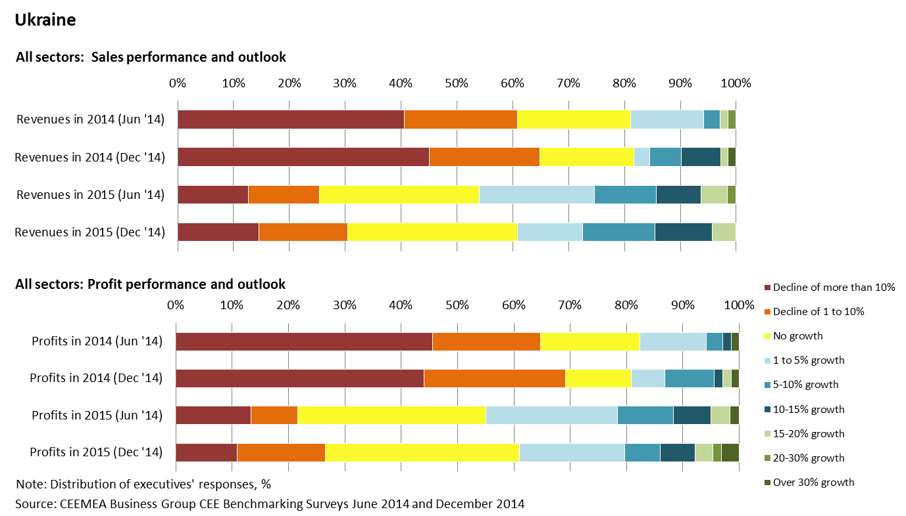
Revenue and profit results/forecasts 2014-15 all sectors, comparison of our June and December 2014 surveys

Slide 45
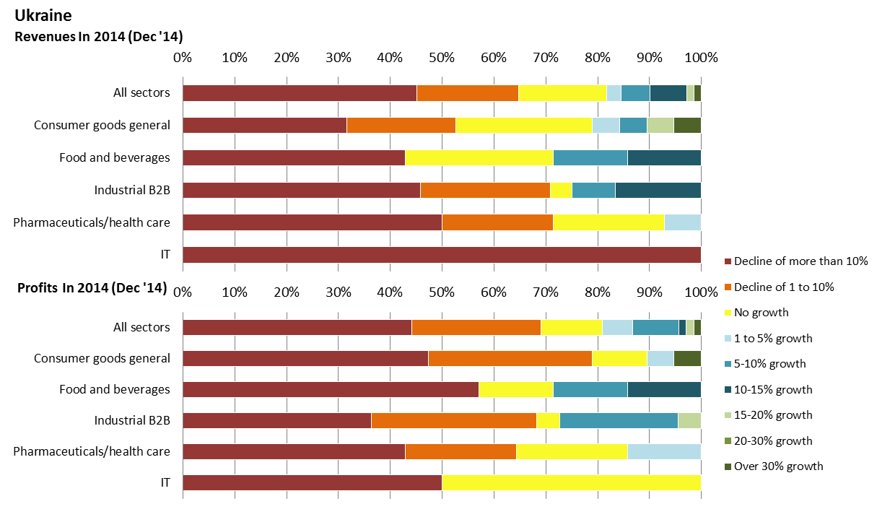
Revenue and profit result estimates 2014 by sector, from our December 2014 survey

Slide 46
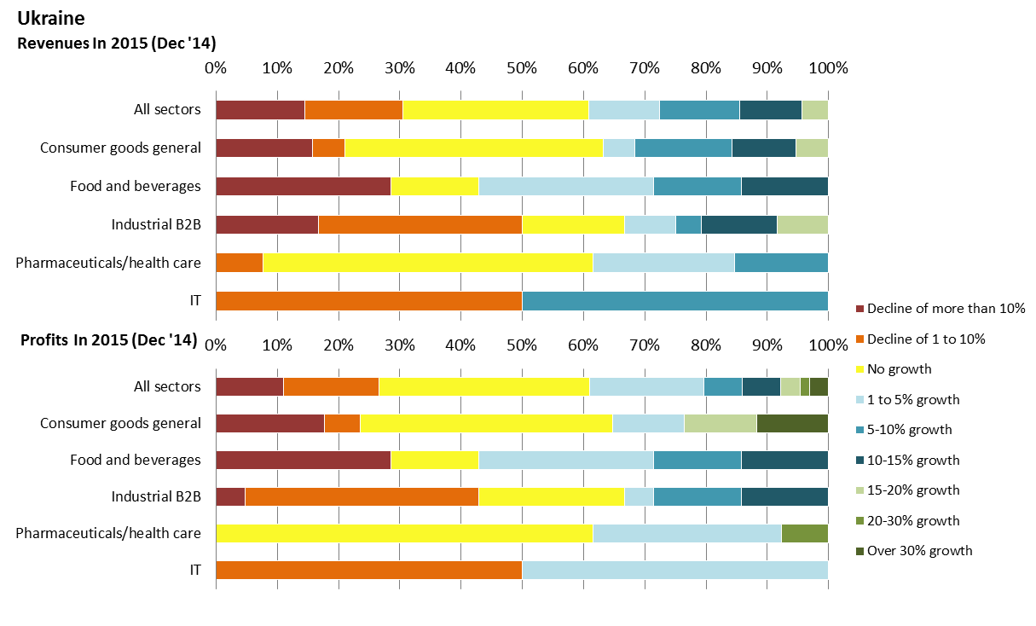
Latest forecasts: revenue and profit forecasts, 2015 by sector , from our December 2014 survey

Slide 47
Ukraine - economic outlook: statistics
 | 2012 | 2013 | 2014 | 2015 | 2016 | 2017 | 2018
GDP | 0.2 | 0.0 | -7.3 | -2.6 | 3.0 | 4.3 | 4.8
Fixed investment | 0.9 | -6.6 | -25.0 | -5.2 | 4.6 | 5.2 | 5.8
Industrial output | -0.5 | -4.3 | -11.0 | -3.3 | 3.0 | 4.5 | 4.8
Household spending | 9.1 | 7.8 | -5.5 | -4.8 | 2.2 | 3.4 | 3.8
Government spending | 3.6 | 2.7 | -5.0 | -4.0 | 0.8 | 1.4 | 1.4
Real wages | 13.5 | 7.9 | -1.0 | -8.0 | -1.1 | 3.3 | 3.2
Retail sales | 17.4 | 8.0 | -9.5 | -5.4 | 3.4 | 3.7 | 4.9
Consumer prices (average) | 0.6 | -0.3 | 12.5 | 16.0 | 8.5 | 6.6 | 6.0
Budget deficit (% GDP) | -3.8 | -4.4 | -6.4 | -5.4 | -3.9 | -2.8 | -2.7
Current account (% GDP) | -8.2 | -9.3 | -3.3 | -2.7 | -2.8 | -2.9 | -4.0
Exports | -6.0 | -8.0 | -23.0 | 0.0 | 5.0 | 6.0 | 7.2
Imports | 1.9 | -6.0 | -34.0 | -2.0 | 5.5 | 6.2 | 7.8
Hryvnia/Euro (average) | 10.5 | 10.7 | 15.7 | 16.5 | 17.4 | 17.5 | 18.0
Hryvnia/dollar (average) | 8.08 | 8.1 | 11.9 | 14.3 | 15.0 | 15.4 | 16.1
Unemployment (%) | 7.9 | 8.7 | 9.6 | 9.3 | 7.8 | 7.2 | 6.7
Note: Real annual % change unless stated

Slide 48
© 2015 CEEMEA Business Group*
*a joint venture between
DT-Global Business Consulting GmbH, Address: Keinergasse 8/33, 1030 Vienna, Austria,
Company registration: FN 331137t
and GSA Global Success Advisors GmbH, Hoffeldstraße 5, 2522 Oberwaltersdorf, Austria
Company registration: FN 331082k
Source: DT-Global Business Consulting GmbH and CEEMEA Business Group research
Basic data sources come from central banks, own intelligence network, CEEMEA Business Group corporate survey, governments and other public sources. Interpretation, views, forecasts, business quotes and business outlooks by DT-Global Business Consulting GmbH and CEEMEA Business Group.
This material is provided for information purposes only. It is not a recommendation or advice of any investment or commercial activity whatsoever. The CEEMEA Business Group accepts no liability for any commercial losses incurred by any party acting on information in these materials.
Contact: Dr Daniel Thorniley, President, DT-Global Business Consulting GmbH
M: +43 676 534 6852 / E: danielthorniley@dt-gbc.com / W: www.ceemeabusinessgroup.com

